Slide 1

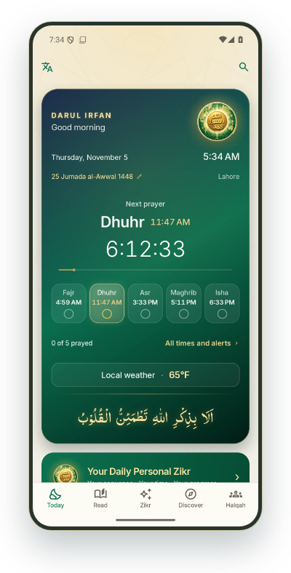
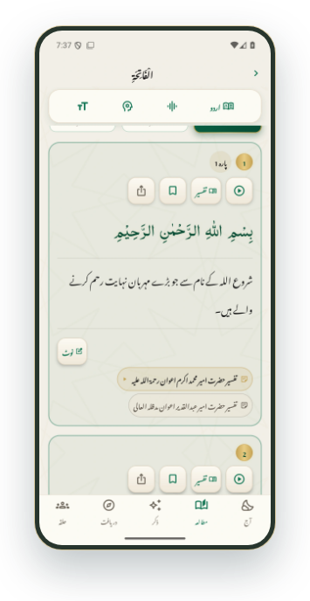
Darul Irfan
دارالعرفان
Quran, Zikr and the Silsila
in daily life
قرآن، ذکر اور سلسلے کی رہنمائی
روزمرہ زندگی کے ساتھ
Explore the app →
ENGLISH & URDU · iOS & ANDROID
Quran · Worship · Community
SILSILA NAQSHBANDIA OWAISIAH
App map
All features
01 / 65
‹
›
Notes:
Darul Irfan
دارالعرفان
Interactive screen previews: keep Darul-Irfan-Interactive-Showcase-v5.html beside the PowerPoint. Open hyperlinks in Slide Show mode.
Android screenshots captured 4 November 2026 from local debug build 21 including the in-progress interface changes (27b5147 and the later 3a944a9 speech update). Administration and live Zikr screens were captured on 5 November 2026 signed in as a super admin, with a Test Zikr on Canada (nobody notified), and the Silsila Markaz screens; member names, emails and places are blurred. All included screen images were captured in this pass.
iOS counterpart checked against local i-content source. No historical iOS screenshots are used.
Original artwork: DarulIrfanApp/Resources/Images/Assets.xcassets/BrandEmblem.imageset and islamic-pattern.imageset.

Slide 2

DARUL IRFAN
THE APP AT A GLANCE
One app. Five places to begin
ایک ایپ، پانچ اہم حصے
Darul Irfan
دارالعرفان
Today
↗
Read
↗
Zikr
↗
Discover
↗
Halqah
↗
آج
مطالعہ
ذکر
دریافت
حلقہ
Today
↗
Quran
↗
Our Sheikh
↗
Audio & video bayans
↗
Halqahs
↗
آج
قرآن
ہمارے شیخ
آڈیو اور ویڈیو بیانات
حلقے
Prayer times
↗
Translation & tafsir
↗
Personal Zikr
↗
Topics
↗
The Silsila
↗
نماز کے اوقات
ترجمہ اور تفسیر
ذاتی ذکر
موضوعات
سلسلے کا تعارف
Today’s Light
↗
Recitation & audio bayan
↗
Tasbih
↗
News & events
↗
Live Zikr stage
↗
آج کی روشنی
تلاوت اور آڈیو بیان
تسبیح
خبریں اور تقریبات
لائیو ذکر کا اسٹیج
Everyday tools
↗
Memorisation
↗
Method of Zikr
↗
Administration
↗
روزمرہ کی سہولتیں
حفظ کی مشق
طریقۂ ذکر
انتظامی سہولتیں
My Day
↗
Hadith
↗
میرا دن
حدیث
Library
↗
کتب خانہ
ACROSS THE APP
Language · Appearance · Location · Reminders · Search & saved
زبان، انداز، مقام، یاددہانی، تلاش اور محفوظ مواد
SILSILA NAQSHBANDIA OWAISIAH
App map
All features
02 / 65
‹
›
Notes:
One app. Five places to begin
ایک ایپ، پانچ اہم حصے
Interactive screen previews: keep Darul-Irfan-Interactive-Showcase-v5.html beside the PowerPoint. Open hyperlinks in Slide Show mode.
Android screenshots captured 4 November 2026 from local debug build 21 including the in-progress interface changes (27b5147 and the later 3a944a9 speech update). Administration and live Zikr screens were captured on 5 November 2026 signed in as a super admin, with a Test Zikr on Canada (nobody notified), and the Silsila Markaz screens; member names, emails and places are blurred. All included screen images were captured in this pass.
iOS counterpart checked against local i-content source. No historical iOS screenshots are used.
Original artwork: DarulIrfanApp/Resources/Images/Assets.xcassets/BrandEmblem.imageset and islamic-pattern.imageset.

Slide 3

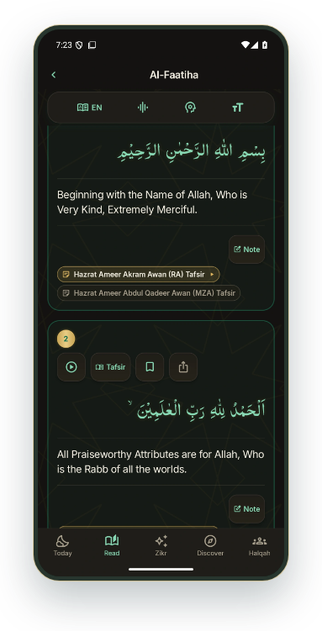
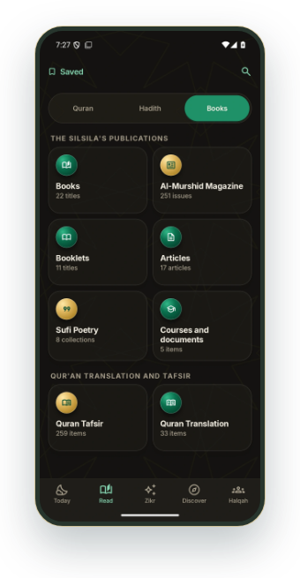
DARUL IRFAN
THE VISION
ANDROID APP PREVIEW
Every teaching, one living
app
تمام تعلیمات، ایک زندہ ایپ
The Qur'an with the Silsila's translation and tafsir, hadith, books,
bayans and Zikr, joined up.
سلسلے کے ترجمہ و تفسیر کے ساتھ قرآن، حدیث، کتب، بیانات اور ذکر، سب ایک دوسرے سے جڑے ہوئے۔
From an ayah to its tafsir and the Sheikh's bayan
↗
آیت سے اس کی تفسیر اور شیخ کے بیان تک
The library and Al-Murshid always at hand
↗
کتب خانہ اور المرشد ہمیشہ ساتھ
Daily Zikr, Halqahs and the Method in the same place
↗
روزانہ ذکر، حلقے اور طریقۂ ذکر ایک جگہ
Al-Faatiha · Ayah tools
Library · Publications
SILSILA NAQSHBANDIA OWAISIAH
App map
All features
03 / 65
‹
›
Notes:
Every teaching, one living app
تمام تعلیمات، ایک زندہ ایپ
The Qur'an with the Silsila's translation and tafsir, hadith, books, bayans and Zikr, joined up.
سلسلے کے ترجمہ و تفسیر کے ساتھ قرآن، حدیث، کتب، بیانات اور ذکر، سب ایک دوسرے سے جڑے ہوئے۔
Interactive screen previews: keep Darul-Irfan-Interactive-Showcase-v5.html beside the PowerPoint. Open hyperlinks in Slide Show mode.
Android screenshots captured 4 November 2026 from local debug build 21 including the in-progress interface changes (27b5147 and the later 3a944a9 speech update). Administration and live Zikr screens were captured on 5 November 2026 signed in as a super admin, with a Test Zikr on Canada (nobody notified), and the Silsila Markaz screens; member names, emails and places are blurred. All included screen images were captured in this pass.
iOS counterpart checked against local i-content source. No historical iOS screenshots are used.
Original artwork: DarulIrfanApp/Resources/Images/Assets.xcassets/BrandEmblem.imageset and islamic-pattern.imageset.

Slide 4

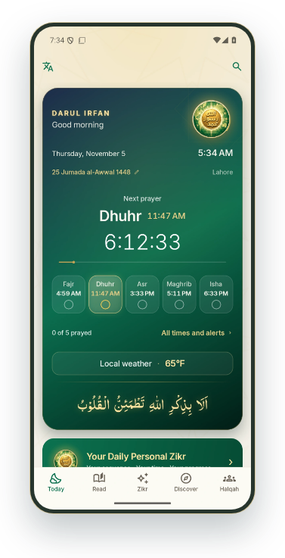
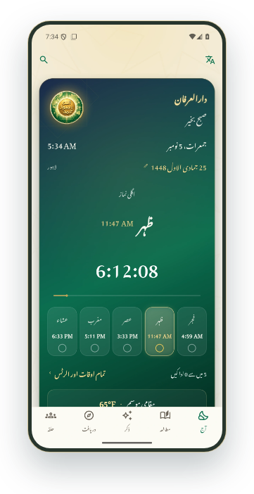
DARUL IRFAN
THE VISION
ANDROID APP PREVIEW
A better experience for
everyone
ہر ایک کے لیے بہتر تجربہ
Calm, clear and bilingual: easy for those who have been with the
Silsila for years, and for someone opening it today.
پرسکون، واضح اور دو لسانی: برسوں سے وابستہ ساتھیوں کے لیے بھی آسان، اور آج پہلی بار کھولنے والے کے لیے بھی۔
English and Urdu, in Nastaliq, on one tap
↗
انگریزی اور اردو، نستعلیق کے ساتھ، ایک ٹیپ پر
Large text, dark and light, works offline
↗
بڑا متن، روشن اور تاریک انداز، آف لائن بھی
One home for prayer, reading and Zikr
↗
نماز، مطالعہ اور ذکر کا ایک ہی گھر
Today · English
Today · Urdu
SILSILA NAQSHBANDIA OWAISIAH
App map
All features
04 / 65
‹
›
Notes:
A better experience for everyone
ہر ایک کے لیے بہتر تجربہ
Calm, clear and bilingual: easy for those who have been with the Silsila for years, and for someone opening it today.
پرسکون، واضح اور دو لسانی: برسوں سے وابستہ ساتھیوں کے لیے بھی آسان، اور آج پہلی بار کھولنے والے کے لیے بھی۔
Interactive screen previews: keep Darul-Irfan-Interactive-Showcase-v5.html beside the PowerPoint. Open hyperlinks in Slide Show mode.
Android screenshots captured 4 November 2026 from local debug build 21 including the in-progress interface changes (27b5147 and the later 3a944a9 speech update). Administration and live Zikr screens were captured on 5 November 2026 signed in as a super admin, with a Test Zikr on Canada (nobody notified), and the Silsila Markaz screens; member names, emails and places are blurred. All included screen images were captured in this pass.
iOS counterpart checked against local i-content source. No historical iOS screenshots are used.
Original artwork: DarulIrfanApp/Resources/Images/Assets.xcassets/BrandEmblem.imageset and islamic-pattern.imageset.

Slide 5

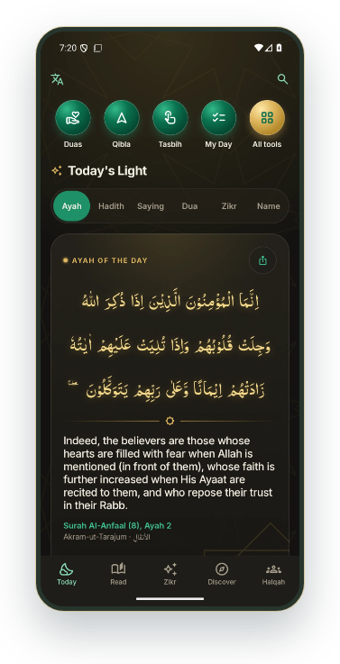
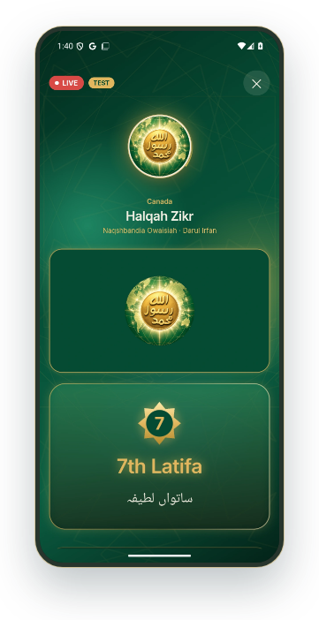
DARUL IRFAN
THE VISION
ANDROID APP PREVIEW
Reaching a new generation
نئی نسل تک رسائی
Young people live on their phones, on YouTube and on social
media. The Silsila now meets them there, in their language.
نوجوان اپنے فون، یوٹیوب اور سوشل میڈیا پر رہتے ہیں۔ سلسلہ اب انہیں وہیں، ان کی زبان میں ملتا ہے۔
A daily ayah, hadith and the Sheikh's sayings, made to share
↗
روزانہ آیت، حدیث اور اقوالِ شیخ، شیئر کرنے کے لیے
The live stage on YouTube and Facebook, beautiful on any screen
↗
یوٹیوب اور فیس بک پر لائیو اسٹیج، ہر اسکرین پر خوبصورت
Gentle habits: reminders, Tasbih and personal Zikr
↗
نرم عادات: یاددہانی، تسبیح اور ذاتی ذکر
Today’s Light · Daily ayah
Stage · 7th Latifa
SILSILA NAQSHBANDIA OWAISIAH
App map
All features
05 / 65
‹
›
Notes:
Reaching a new generation
نئی نسل تک رسائی
Young people live on their phones, on YouTube and on social media. The Silsila now meets them there, in their language.
نوجوان اپنے فون، یوٹیوب اور سوشل میڈیا پر رہتے ہیں۔ سلسلہ اب انہیں وہیں، ان کی زبان میں ملتا ہے۔
Interactive screen previews: keep Darul-Irfan-Interactive-Showcase-v5.html beside the PowerPoint. Open hyperlinks in Slide Show mode.
Android screenshots captured 4 November 2026 from local debug build 21 including the in-progress interface changes (27b5147 and the later 3a944a9 speech update). Administration and live Zikr screens were captured on 5 November 2026 signed in as a super admin, with a Test Zikr on Canada (nobody notified), and the Silsila Markaz screens; member names, emails and places are blurred. All included screen images were captured in this pass.
iOS counterpart checked against local i-content source. No historical iOS screenshots are used.
Original artwork: DarulIrfanApp/Resources/Images/Assets.xcassets/BrandEmblem.imageset and islamic-pattern.imageset.

Slide 6
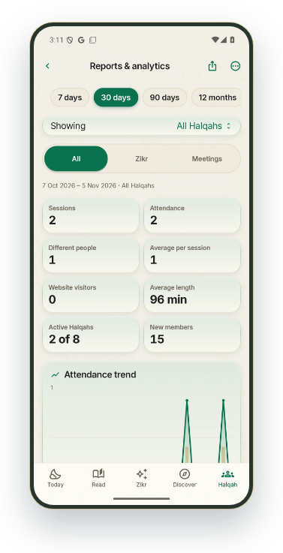
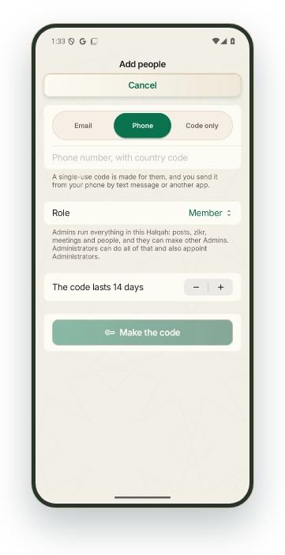
DARUL IRFAN
THE VISION
ANDROID APP PREVIEW
How we bring in new
audiences
نئے سامعین کیسے آئیں گے
Open doors, no barriers: anyone can follow a live Zikr from a link,
and the Markaz can see what draws people in.
کھلے دروازے، کوئی رکاوٹ نہیں: کوئی بھی ایک لنک سے لائیو ذکر میں شامل ہو سکتا ہے، اور مرکز دیکھ سکتا ہے کہ لوگ کس چیز سے آتے ہیں۔
Websites open to all: a name and a city, then the live Zikr
سب کے لیے ویب سائٹس: نام اور شہر، پھر لائیو ذکر
Invitations by WhatsApp link and code, in seconds
↗
واٹس ایپ لنک اور کوڈ سے دعوت، سیکنڈوں میں
Reports show new members, visitors and growth
↗
رپورٹس نئے ممبر، مہمان اور ترقی دکھاتی ہیں
Ideas the Markaz can run: share each daily card, stream every Daily Zikr, invite from each Ijtema, follow the new-visitor
figures monthly.
Reports & analytics
Add people · Invitation code
SILSILA NAQSHBANDIA OWAISIAH
App map
All features
06 / 65
‹
›
Notes:
How we bring in new audiences
نئے سامعین کیسے آئیں گے
Open doors, no barriers: anyone can follow a live Zikr from a link, and the Markaz can see what draws people in.
کھلے دروازے، کوئی رکاوٹ نہیں: کوئی بھی ایک لنک سے لائیو ذکر میں شامل ہو سکتا ہے، اور مرکز دیکھ سکتا ہے کہ لوگ کس چیز سے آتے ہیں۔
Ideas the Markaz can run: share each daily card, stream every Daily Zikr, invite from each Ijtema, follow the new-visitor figures monthly.
Interactive screen previews: keep Darul-Irfan-Interactive-Showcase-v5.html beside the PowerPoint. Open hyperlinks in Slide Show mode.
Android screenshots captured 4 November 2026 from local debug build 21 including the in-progress interface changes (27b5147 and the later 3a944a9 speech update). Administration and live Zikr screens were captured on 5 November 2026 signed in as a super admin, with a Test Zikr on Canada (nobody notified), and the Silsila Markaz screens; member names, emails and places are blurred. All included screen images were captured in this pass.
iOS counterpart checked against local i-content source. No historical iOS screenshots are used.
Original artwork: DarulIrfanApp/Resources/Images/Assets.xcassets/BrandEmblem.imageset and islamic-pattern.imageset.

Slide 7

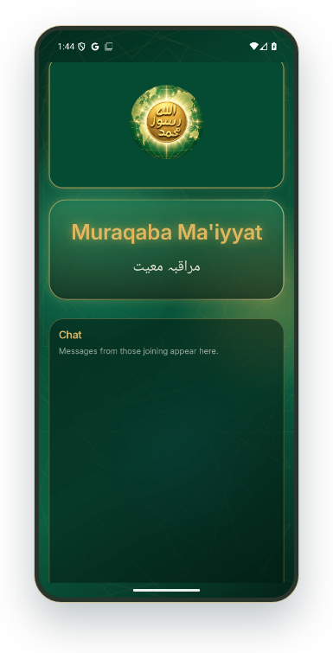
DARUL IRFAN
THE VISION
ANDROID APP PREVIEW
On every major platform
ہر بڑے پلیٹ فارم پر
iPhone, Android, the web, YouTube, Facebook and Paltalk, one Silsila, one
look: a modern portfolio for a timeless message.
آئی فون، اینڈرائیڈ، ویب، یوٹیوب، فیس بک اور پالٹاک، ایک سلسلہ، ایک انداز: ایک لازوال پیغام کے لیے جدید پہچان۔
Native apps on iOS and Android, built together
↗
آئی او ایس اور اینڈرائیڈ پر ایک ساتھ بنی ایپس
Regional websites for Our Sheikh, North America and the UK
ہمارے شیخ، شمالی امریکہ اور برطانیہ کی ویب سائٹس
YouTube and Facebook carry the live stage
↗
یوٹیوب اور فیس بک پر لائیو اسٹیج
Presentation view
SILSILA NAQSHBANDIA OWAISIAH
App map
All features
07 / 65
‹
›
Notes:
On every major platform
ہر بڑے پلیٹ فارم پر
iPhone, Android, the web, YouTube, Facebook and Paltalk, one Silsila, one look: a modern portfolio for a timeless message.
آئی فون، اینڈرائیڈ، ویب، یوٹیوب، فیس بک اور پالٹاک، ایک سلسلہ، ایک انداز: ایک لازوال پیغام کے لیے جدید پہچان۔
Interactive screen previews: keep Darul-Irfan-Interactive-Showcase-v5.html beside the PowerPoint. Open hyperlinks in Slide Show mode.
Android screenshots captured 4 November 2026 from local debug build 21 including the in-progress interface changes (27b5147 and the later 3a944a9 speech update). Administration and live Zikr screens were captured on 5 November 2026 signed in as a super admin, with a Test Zikr on Canada (nobody notified), and the Silsila Markaz screens; member names, emails and places are blurred. All included screen images were captured in this pass.
iOS counterpart checked against local i-content source. No historical iOS screenshots are used.
Original artwork: DarulIrfanApp/Resources/Images/Assets.xcassets/BrandEmblem.imageset and islamic-pattern.imageset.

Slide 8

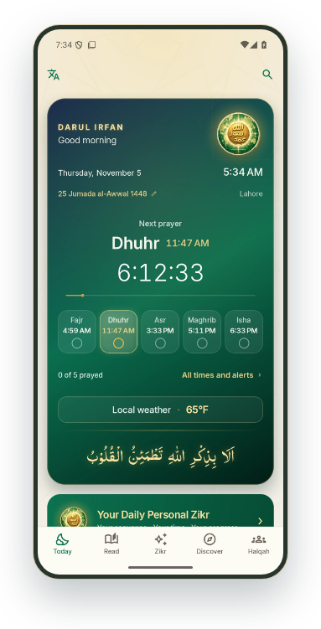
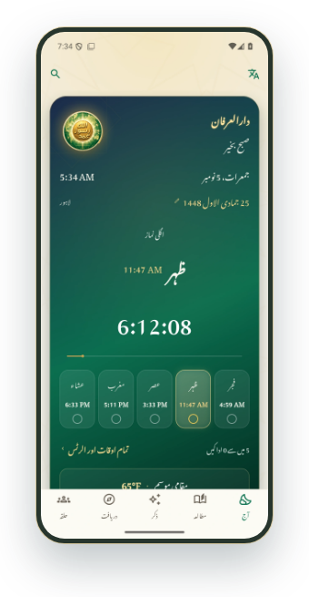
DARUL IRFAN
TODAY
ANDROID APP PREVIEW
Your day, with purpose
روزمرہ زندگی میں عبادت کا ساتھ
Prayer, daily guidance and personal practice are brought
together on Today.
نماز کے اوقات، روزانہ کی رہنمائی اور ذاتی ذکر ایک ہی جگہ۔
Local time, Hijri date and weather
↗
مقامی وقت، اسلامی تاریخ اور موسم
Prayer times at a glance
↗
نماز کے اوقات ایک نظر میں
A direct route to personal Zikr
↗
ذاتی ذکر فوراً کھولیں
Today · English
Today · Urdu
SILSILA NAQSHBANDIA OWAISIAH
App map
All features
08 / 65
‹
›
Notes:
Your day, with purpose
روزمرہ زندگی میں عبادت کا ساتھ
Prayer, daily guidance and personal practice are brought together on Today.
نماز کے اوقات، روزانہ کی رہنمائی اور ذاتی ذکر ایک ہی جگہ۔
Interactive screen previews: keep Darul-Irfan-Interactive-Showcase-v5.html beside the PowerPoint. Open hyperlinks in Slide Show mode.
Android screenshots captured 4 November 2026 from local debug build 21 including the in-progress interface changes (27b5147 and the later 3a944a9 speech update). Administration and live Zikr screens were captured on 5 November 2026 signed in as a super admin, with a Test Zikr on Canada (nobody notified), and the Silsila Markaz screens; member names, emails and places are blurred. All included screen images were captured in this pass.
iOS counterpart checked against local i-content source. No historical iOS screenshots are used.
Original artwork: DarulIrfanApp/Resources/Images/Assets.xcassets/BrandEmblem.imageset and islamic-pattern.imageset.

Slide 9

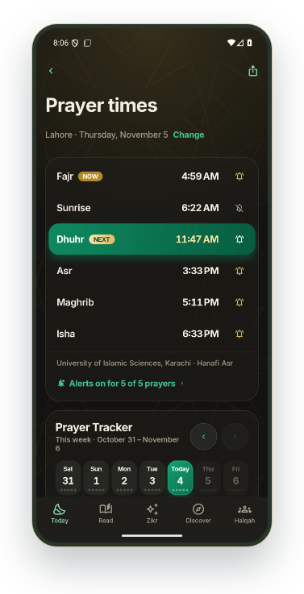
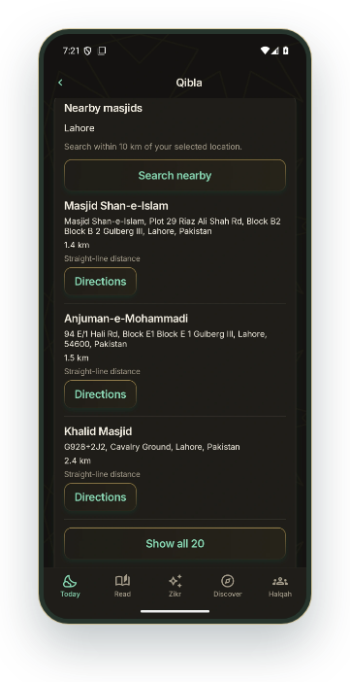
DARUL IRFAN
TODAY
ANDROID APP PREVIEW
Know the time. Find the
direction.
نماز کا وقت اور قبلے کی سمت
Plan prayer around your location, then find a nearby masjid when
you need one.
اپنے مقام کے مطابق اوقات دیکھیں اور ضرورت پر قریبی مسجد تلاش کریں۔
Prayer timetable and completion tracker
↗
نماز کا جدول اور ادائیگی کا ریکارڈ
Qibla compass and true-north bearing
↗
قبلہ کمپاس اور سمت کی رہنمائی
Nearby masjids, distance and directions
↗
قریبی مساجد، فاصلہ اور راستہ
Nearby search and directions require internet and a selected location.
Prayer times & tracker
Nearby masjid results
SILSILA NAQSHBANDIA OWAISIAH
App map
All features
09 / 65
‹
›
Notes:
Know the time. Find the direction.
نماز کا وقت اور قبلے کی سمت
Plan prayer around your location, then find a nearby masjid when you need one.
اپنے مقام کے مطابق اوقات دیکھیں اور ضرورت پر قریبی مسجد تلاش کریں۔
Nearby search and directions require internet and a selected location.
Interactive screen previews: keep Darul-Irfan-Interactive-Showcase-v5.html beside the PowerPoint. Open hyperlinks in Slide Show mode.
Android screenshots captured 4 November 2026 from local debug build 21 including the in-progress interface changes (27b5147 and the later 3a944a9 speech update). Administration and live Zikr screens were captured on 5 November 2026 signed in as a super admin, with a Test Zikr on Canada (nobody notified), and the Silsila Markaz screens; member names, emails and places are blurred. All included screen images were captured in this pass.
iOS counterpart checked against local i-content source. No historical iOS screenshots are used.
Original artwork: DarulIrfanApp/Resources/Images/Assets.xcassets/BrandEmblem.imageset and islamic-pattern.imageset.

Slide 10

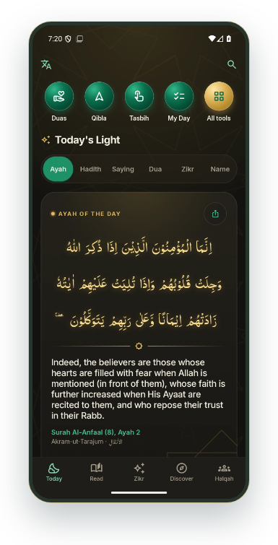
DARUL IRFAN
TODAY
ANDROID APP PREVIEW
A daily reason to return
ہر روز کچھ پڑھیں، کچھ عمل کریں
An ayah, Hadith, saying, dua, zikr and a Name of Allah make up Today’s
Light.
آج کی روشنی میں آیت، حدیث، قول، دعا، ذکر اور اللہ کا ایک نام دیکھیں۔
Read the daily ayah
↗
آج کی آیت پڑھیں
Open tafsir for today’s ayah
↗
آج کی آیت کی تفسیر کھولیں
Keep a private routine in My Day
میرا دن میں اپنا معمول سنبھالیں
Today’s Light · Daily ayah
SILSILA NAQSHBANDIA OWAISIAH
App map
All features
10 / 65
‹
›
Notes:
A daily reason to return
ہر روز کچھ پڑھیں، کچھ عمل کریں
An ayah, Hadith, saying, dua, zikr and a Name of Allah make up Today’s Light.
آج کی روشنی میں آیت، حدیث، قول، دعا، ذکر اور اللہ کا ایک نام دیکھیں۔
Interactive screen previews: keep Darul-Irfan-Interactive-Showcase-v5.html beside the PowerPoint. Open hyperlinks in Slide Show mode.
Android screenshots captured 4 November 2026 from local debug build 21 including the in-progress interface changes (27b5147 and the later 3a944a9 speech update). Administration and live Zikr screens were captured on 5 November 2026 signed in as a super admin, with a Test Zikr on Canada (nobody notified), and the Silsila Markaz screens; member names, emails and places are blurred. All included screen images were captured in this pass.
iOS counterpart checked against local i-content source. No historical iOS screenshots are used.
Original artwork: DarulIrfanApp/Resources/Images/Assets.xcassets/BrandEmblem.imageset and islamic-pattern.imageset.

Slide 11
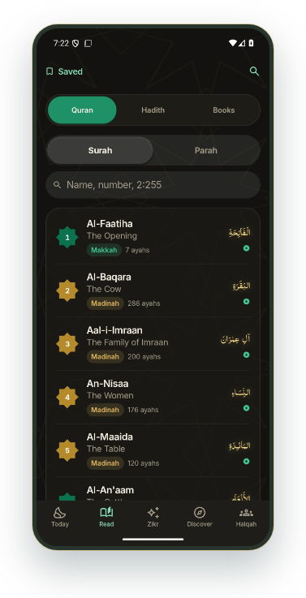

DARUL IRFAN
READ
ANDROID APP PREVIEW
The Quran, always close
قرآن کا مطالعہ، ہر وقت ساتھ
Open a surah, choose a parah, or return to the ayah where you
stopped.
سورت یا پارہ کھولیں، یا جہاں مطالعہ چھوڑا تھا وہیں سے جاری رکھیں۔
Browse all 114 surahs
↗
تمام 114 سورتیں دیکھیں
Browse all 30 parahs
↗
تمام 30 پارے دیکھیں
Read Arabic with translation
↗
عربی متن کے ساتھ ترجمہ پڑھیں
Quran · Surah list
Al-Faatiha · Urdu translation
SILSILA NAQSHBANDIA OWAISIAH
App map
All features
11 / 65
‹
›
Notes:
The Quran, always close
قرآن کا مطالعہ، ہر وقت ساتھ
Open a surah, choose a parah, or return to the ayah where you stopped.
سورت یا پارہ کھولیں، یا جہاں مطالعہ چھوڑا تھا وہیں سے جاری رکھیں۔
Interactive screen previews: keep Darul-Irfan-Interactive-Showcase-v5.html beside the PowerPoint. Open hyperlinks in Slide Show mode.
Android screenshots captured 4 November 2026 from local debug build 21 including the in-progress interface changes (27b5147 and the later 3a944a9 speech update). Administration and live Zikr screens were captured on 5 November 2026 signed in as a super admin, with a Test Zikr on Canada (nobody notified), and the Silsila Markaz screens; member names, emails and places are blurred. All included screen images were captured in this pass.
iOS counterpart checked against local i-content source. No historical iOS screenshots are used.
Original artwork: DarulIrfanApp/Resources/Images/Assets.xcassets/BrandEmblem.imageset and islamic-pattern.imageset.

Slide 12
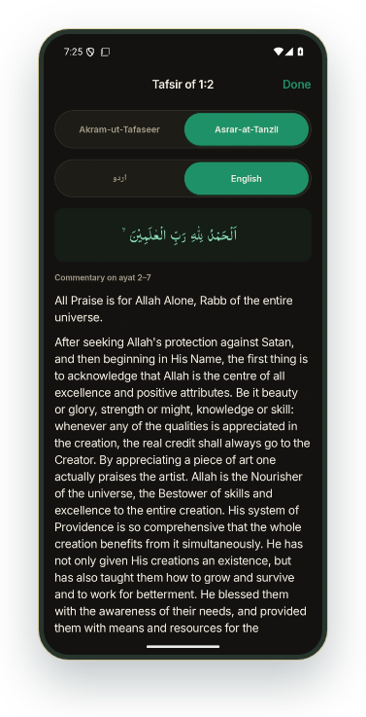
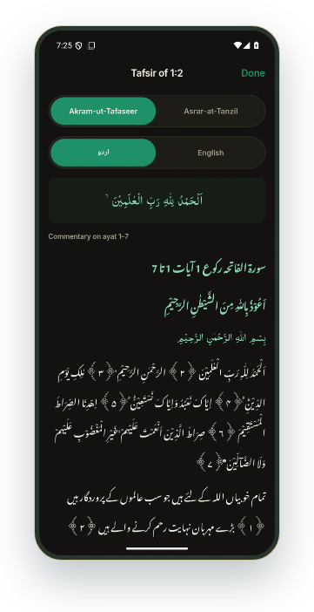
DARUL IRFAN
READ
ANDROID APP PREVIEW
Understanding begins at
the ayah
اسی آیت کا ترجمہ اور تفسیر
Akram-ut-Tarajum, Akram-ut-Tafaseer and Asrar-at-Tanzil
connect reading with deeper study.
اکرم التراجم، اکرم التفاسیر اور اسرار التنزیل کے ذریعے آیت کو مزید سمجھیں۔
Translation beside the Arabic text
↗
عربی متن کے ساتھ ترجمہ
English tafsir for the selected ayah
↗
منتخب آیت کی انگریزی تفسیر
Urdu tafsir in the same reader
↗
اسی صفحے پر اردو تفسیر
Commentary availability varies by work and language; full-volume alternatives are offered where available.
Asrar-at-Tanzil · English tafsir
Akram-ut-Tafaseer · Urdu tafsir
SILSILA NAQSHBANDIA OWAISIAH
App map
All features
12 / 65
‹
›
Notes:
Understanding begins at the ayah
اسی آیت کا ترجمہ اور تفسیر
Akram-ut-Tarajum, Akram-ut-Tafaseer and Asrar-at-Tanzil connect reading with deeper study.
اکرم التراجم، اکرم التفاسیر اور اسرار التنزیل کے ذریعے آیت کو مزید سمجھیں۔
Commentary availability varies by work and language; full-volume alternatives are offered where available.
Interactive screen previews: keep Darul-Irfan-Interactive-Showcase-v5.html beside the PowerPoint. Open hyperlinks in Slide Show mode.
Android screenshots captured 4 November 2026 from local debug build 21 including the in-progress interface changes (27b5147 and the later 3a944a9 speech update). Administration and live Zikr screens were captured on 5 November 2026 signed in as a super admin, with a Test Zikr on Canada (nobody notified), and the Silsila Markaz screens; member names, emails and places are blurred. All included screen images were captured in this pass.
iOS counterpart checked against local i-content source. No historical iOS screenshots are used.
Original artwork: DarulIrfanApp/Resources/Images/Assets.xcassets/BrandEmblem.imageset and islamic-pattern.imageset.

Slide 13

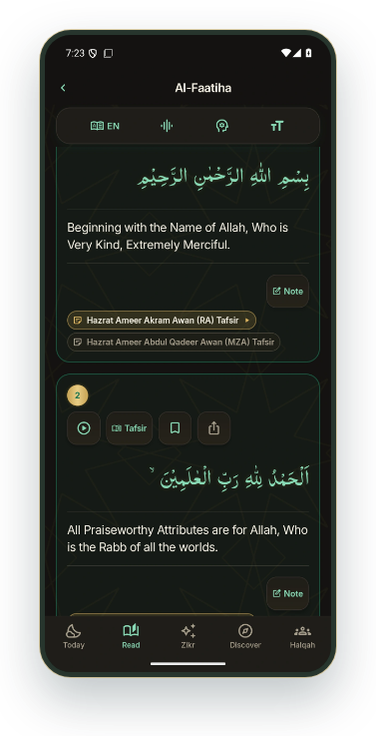
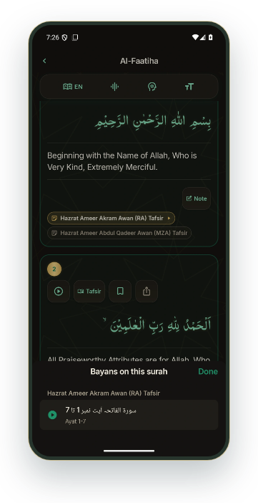
DARUL IRFAN
READ
ANDROID APP PREVIEW
Read. Listen. Stay with the
ayah.
آیت پڑھیں، تلاوت اور آڈیو بیان سنیں
The ayah reader brings recitation, tafsir and matching Sheikh
bayans into the same journey.
آیت کے ساتھ تلاوت، تفسیر اور متعلقہ آڈیو بیان تک آسانی سے پہنچیں۔
Play from an individual ayah
↗
منتخب آیت سے تلاوت سنیں
Open linked Sheikh tafsir bayans
↗
شیخ کے متعلقہ آڈیو بیانات کھولیں
Continue native audio in the background
ایپ کی آڈیو بیک گراؤنڈ میں جاری رکھیں
Bayan links appear where matching recordings exist. YouTube follows its own playback restrictions.
Al-Faatiha · Ayah tools
Al-Faatiha · Linked audio bayan
SILSILA NAQSHBANDIA OWAISIAH
App map
All features
13 / 65
‹
›
Notes:
Read. Listen. Stay with the ayah.
آیت پڑھیں، تلاوت اور آڈیو بیان سنیں
The ayah reader brings recitation, tafsir and matching Sheikh bayans into the same journey.
آیت کے ساتھ تلاوت، تفسیر اور متعلقہ آڈیو بیان تک آسانی سے پہنچیں۔
Bayan links appear where matching recordings exist. YouTube follows its own playback restrictions.
Interactive screen previews: keep Darul-Irfan-Interactive-Showcase-v5.html beside the PowerPoint. Open hyperlinks in Slide Show mode.
Android screenshots captured 4 November 2026 from local debug build 21 including the in-progress interface changes (27b5147 and the later 3a944a9 speech update). Administration and live Zikr screens were captured on 5 November 2026 signed in as a super admin, with a Test Zikr on Canada (nobody notified), and the Silsila Markaz screens; member names, emails and places are blurred. All included screen images were captured in this pass.
iOS counterpart checked against local i-content source. No historical iOS screenshots are used.
Original artwork: DarulIrfanApp/Resources/Images/Assets.xcassets/BrandEmblem.imageset and islamic-pattern.imageset.

Slide 14
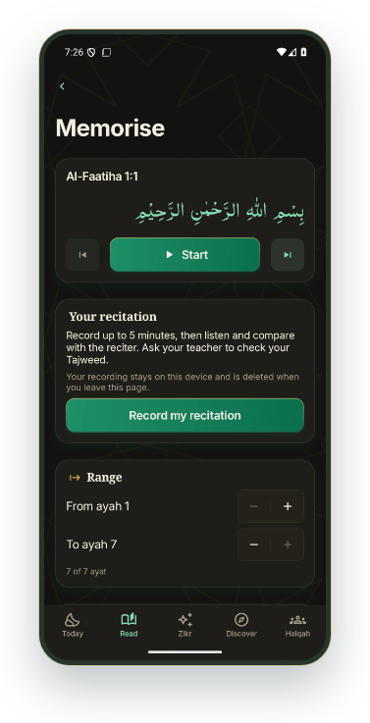
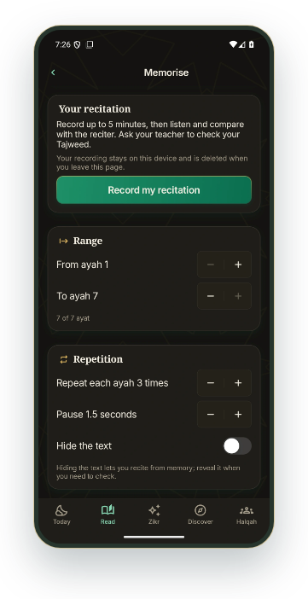
DARUL IRFAN
READ
ANDROID APP PREVIEW
A practice space for
memorisation
قرآن یاد کرنے کی مشق
Choose a passage, repeat each ayah and leave time to recite it
yourself.
آیات منتخب کریں، بار بار سنیں اور خود پڑھنے کے لیے وقفہ رکھیں۔
Choose an ayah range and repetitions
↗
آیات اور سننے کی تعداد منتخب کریں
Hide the text and practise recall
↗
متن چھپا کر یاد سے پڑھیں
Record, replay and compare your recitation
↗
اپنی تلاوت ریکارڈ کر کے دوبارہ سنیں
Private recording supports practice. Tajweed should be checked by a teacher; the app does not provide automated Tajweed
scoring.
Memorisation · Recitation practice
Memorisation · Range & repetition
SILSILA NAQSHBANDIA OWAISIAH
App map
All features
14 / 65
‹
›
Notes:
A practice space for memorisation
قرآن یاد کرنے کی مشق
Choose a passage, repeat each ayah and leave time to recite it yourself.
آیات منتخب کریں، بار بار سنیں اور خود پڑھنے کے لیے وقفہ رکھیں۔
Private recording supports practice. Tajweed should be checked by a teacher; the app does not provide automated Tajweed scoring.
Interactive screen previews: keep Darul-Irfan-Interactive-Showcase-v5.html beside the PowerPoint. Open hyperlinks in Slide Show mode.
Android screenshots captured 4 November 2026 from local debug build 21 including the in-progress interface changes (27b5147 and the later 3a944a9 speech update). Administration and live Zikr screens were captured on 5 November 2026 signed in as a super admin, with a Test Zikr on Canada (nobody notified), and the Silsila Markaz screens; member names, emails and places are blurred. All included screen images were captured in this pass.
iOS counterpart checked against local i-content source. No historical iOS screenshots are used.
Original artwork: DarulIrfanApp/Resources/Images/Assets.xcassets/BrandEmblem.imageset and islamic-pattern.imageset.

Slide 15
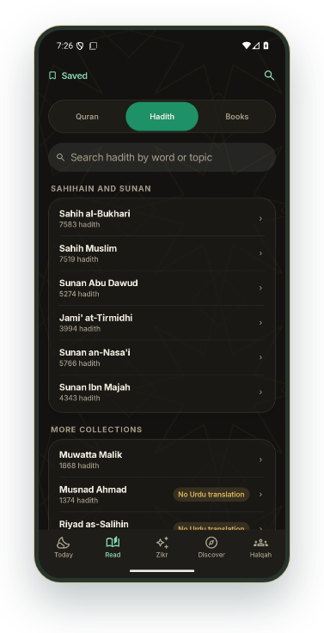
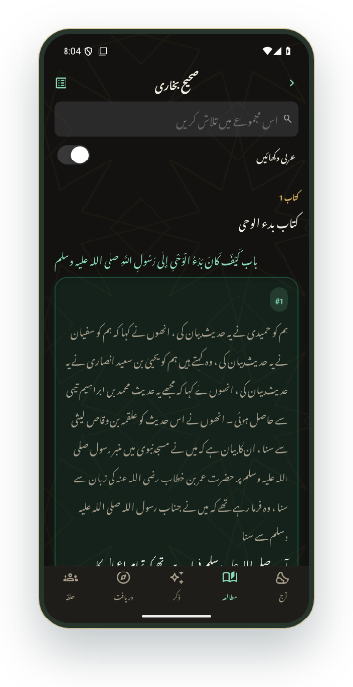
DARUL IRFAN
READ
ANDROID APP PREVIEW
Hadith with its reference
حدیث، اس کے حوالے کے ساتھ
Browse collections and chapters, search a subject, and save a
narration to revisit.
مجموعہ اور باب منتخب کریں، موضوع تلاش کریں اور حدیث محفوظ کر لیں۔
Open the Hadith collections
↗
حدیث کے مجموعے کھولیں
Read an Urdu translation
↗
اردو ترجمہ پڑھیں
Search, save and share narrations
حدیث تلاش، محفوظ اور شیئر کریں
Translation and narrator information depend on the collection. Review labels identify provisional content.
Hadith · Collections
Sahih al-Bukhari · Urdu translation
SILSILA NAQSHBANDIA OWAISIAH
App map
All features
15 / 65
‹
›
Notes:
Hadith with its reference
حدیث، اس کے حوالے کے ساتھ
Browse collections and chapters, search a subject, and save a narration to revisit.
مجموعہ اور باب منتخب کریں، موضوع تلاش کریں اور حدیث محفوظ کر لیں۔
Translation and narrator information depend on the collection. Review labels identify provisional content.
Interactive screen previews: keep Darul-Irfan-Interactive-Showcase-v5.html beside the PowerPoint. Open hyperlinks in Slide Show mode.
Android screenshots captured 4 November 2026 from local debug build 21 including the in-progress interface changes (27b5147 and the later 3a944a9 speech update). Administration and live Zikr screens were captured on 5 November 2026 signed in as a super admin, with a Test Zikr on Canada (nobody notified), and the Silsila Markaz screens; member names, emails and places are blurred. All included screen images were captured in this pass.
iOS counterpart checked against local i-content source. No historical iOS screenshots are used.
Original artwork: DarulIrfanApp/Resources/Images/Assets.xcassets/BrandEmblem.imageset and islamic-pattern.imageset.

Slide 16

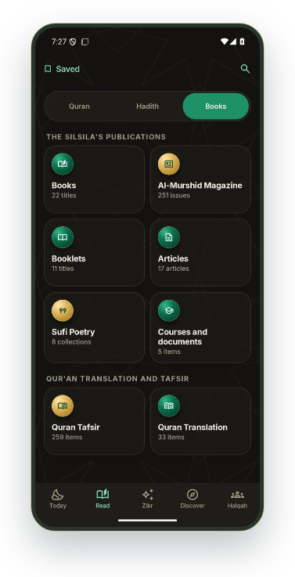
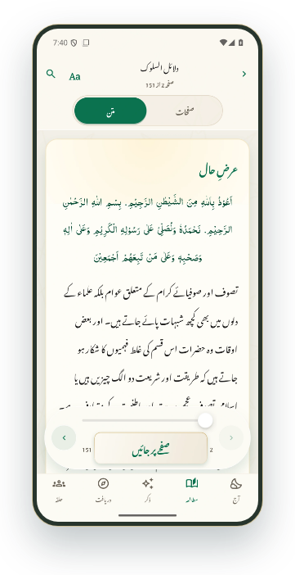
DARUL IRFAN
READ
ANDROID APP PREVIEW
A library beyond the reader
مطالعے کے لیے پورا کتب خانہ
Books, Al-Murshid, articles, poetry and courses keep the Silsila’s
publications within reach.
کتابیں، المرشد، مضامین، شاعری اور کورسز ایک ہی کتب خانے میں۔
Browse the publication categories
↗
مطبوعات کی فہرست دیکھیں
Find Urdu and English publications
↗
اردو اور انگریزی مواد تلاش کریں
Read a book inside the app
↗
ایپ کے اندر کتاب پڑھیں
Library · Publications
Dalael-us-Salook · Text reader
SILSILA NAQSHBANDIA OWAISIAH
App map
All features
16 / 65
‹
›
Notes:
A library beyond the reader
مطالعے کے لیے پورا کتب خانہ
Books, Al-Murshid, articles, poetry and courses keep the Silsila’s publications within reach.
کتابیں، المرشد، مضامین، شاعری اور کورسز ایک ہی کتب خانے میں۔
Interactive screen previews: keep Darul-Irfan-Interactive-Showcase-v5.html beside the PowerPoint. Open hyperlinks in Slide Show mode.
Android screenshots captured 4 November 2026 from local debug build 21 including the in-progress interface changes (27b5147 and the later 3a944a9 speech update). Administration and live Zikr screens were captured on 5 November 2026 signed in as a super admin, with a Test Zikr on Canada (nobody notified), and the Silsila Markaz screens; member names, emails and places are blurred. All included screen images were captured in this pass.
iOS counterpart checked against local i-content source. No historical iOS screenshots are used.
Original artwork: DarulIrfanApp/Resources/Images/Assets.xcassets/BrandEmblem.imageset and islamic-pattern.imageset.

Slide 17
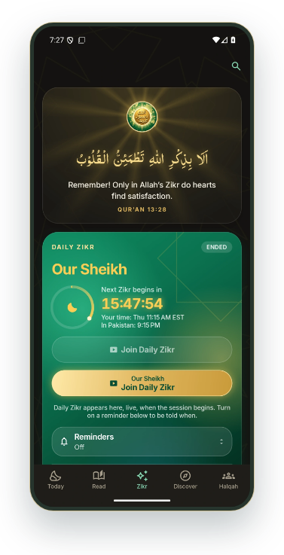
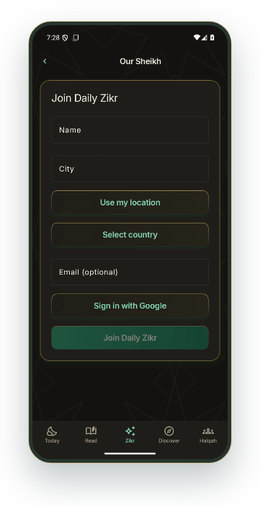
DARUL IRFAN
ZIKR
ANDROID APP PREVIEW
Our Sheikh · Join Daily Zikr
ہمارے شیخ — روزانہ ذکر میں شامل ہوں
A clear entry point connects daily Zikr, local session time and the
Our Sheikh Halqah.
روزانہ ذکر کا مقامی وقت دیکھیں اور ہمارے شیخ کے حلقے میں شامل ہوں۔
See the daily Zikr card
↗
روزانہ ذکر کا کارڈ دیکھیں
Join with name, city and country
↗
نام، شہر اور ملک کے ساتھ شامل ہوں
Keep YouTube and Tahajjud routes within reach
یوٹیوب اور تہجد کے ذکر کے راستے بھی موجود ہیں
Host and live-stage controls are available to authorised roles during a session.
Zikr · Our Sheikh
Our Sheikh · Public join form
SILSILA NAQSHBANDIA OWAISIAH
App map
All features
17 / 65
‹
›
Notes:
Our Sheikh · Join Daily Zikr
ہمارے شیخ — روزانہ ذکر میں شامل ہوں
A clear entry point connects daily Zikr, local session time and the Our Sheikh Halqah.
روزانہ ذکر کا مقامی وقت دیکھیں اور ہمارے شیخ کے حلقے میں شامل ہوں۔
Host and live-stage controls are available to authorised roles during a session.
Interactive screen previews: keep Darul-Irfan-Interactive-Showcase-v5.html beside the PowerPoint. Open hyperlinks in Slide Show mode.
Android screenshots captured 4 November 2026 from local debug build 21 including the in-progress interface changes (27b5147 and the later 3a944a9 speech update). Administration and live Zikr screens were captured on 5 November 2026 signed in as a super admin, with a Test Zikr on Canada (nobody notified), and the Silsila Markaz screens; member names, emails and places are blurred. All included screen images were captured in this pass.
iOS counterpart checked against local i-content source. No historical iOS screenshots are used.
Original artwork: DarulIrfanApp/Resources/Images/Assets.xcassets/BrandEmblem.imageset and islamic-pattern.imageset.

Slide 18
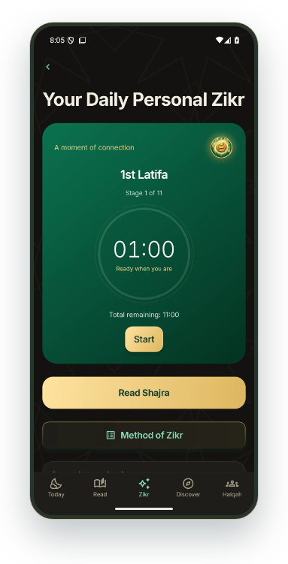
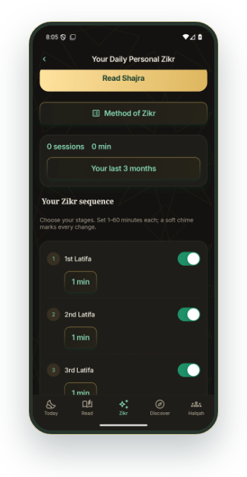
DARUL IRFAN
ZIKR
ANDROID APP PREVIEW
Your own daily Zikr routine
اپنے روزانہ ذکر کا معمول بنائیں
A guided sequence keeps your chosen stages, timings and
progress together.
اپنے منتخب مراحل، وقت اور ذکر کا ریکارڈ ایک جگہ رکھیں۔
Lataif, Raabta and muraqabas
↗
لطائف، رابطہ اور مراقبات
Choose 1–60 minutes for each stage
ہر مرحلے کے لیے 1 سے 60 منٹ منتخب کریں
Add muraqabas and two daily reminders
↗
مزید مراقبات اور دو یاددہانیاں شامل کریں
Personal Zikr · Timer
Personal Zikr · Sequence & Shajra
SILSILA NAQSHBANDIA OWAISIAH
App map
All features
18 / 65
‹
›
Notes:
Your own daily Zikr routine
اپنے روزانہ ذکر کا معمول بنائیں
A guided sequence keeps your chosen stages, timings and progress together.
اپنے منتخب مراحل، وقت اور ذکر کا ریکارڈ ایک جگہ رکھیں۔
Interactive screen previews: keep Darul-Irfan-Interactive-Showcase-v5.html beside the PowerPoint. Open hyperlinks in Slide Show mode.
Android screenshots captured 4 November 2026 from local debug build 21 including the in-progress interface changes (27b5147 and the later 3a944a9 speech update). Administration and live Zikr screens were captured on 5 November 2026 signed in as a super admin, with a Test Zikr on Canada (nobody notified), and the Silsila Markaz screens; member names, emails and places are blurred. All included screen images were captured in this pass.
iOS counterpart checked against local i-content source. No historical iOS screenshots are used.
Original artwork: DarulIrfanApp/Resources/Images/Assets.xcassets/BrandEmblem.imageset and islamic-pattern.imageset.

Slide 19

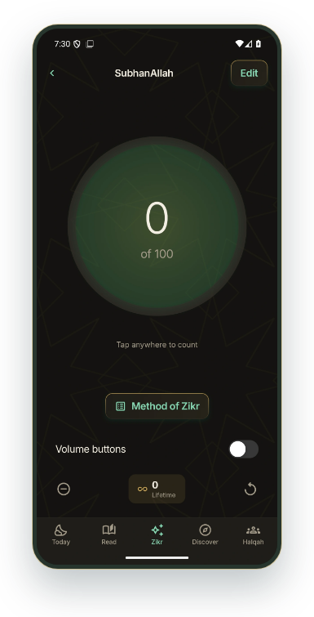
DARUL IRFAN
ZIKR
ANDROID APP PREVIEW
Tap into a steady practice
ذکر کی گنتی آسان رکھیں
Start from a daily zikr or create a personal counter with its own target.
آج کے ذکر سے گنتی شروع کریں یا اپنے ہدف کے ساتھ نئی تسبیح بنائیں۔
A focused, full-screen counter
↗
گنتی کے لیے واضح اور بڑا صفحہ
Targets, correction and lifetime totals
↗
ہدف، گنتی کی درستگی اور مجموعی ریکارڈ
Optional hardware controls
بٹن سے گنتی کا اختیاری طریقہ
SubhanAllah · Counter
Android offers volume-button counting. Compatible iPhones can use a configured Action Button Shortcut.
SILSILA NAQSHBANDIA OWAISIAH
App map
All features
19 / 65
‹
›
Notes:
Tap into a steady practice
ذکر کی گنتی آسان رکھیں
Start from a daily zikr or create a personal counter with its own target.
آج کے ذکر سے گنتی شروع کریں یا اپنے ہدف کے ساتھ نئی تسبیح بنائیں۔
Android offers volume-button counting. Compatible iPhones can use a configured Action Button Shortcut.
Interactive screen previews: keep Darul-Irfan-Interactive-Showcase-v5.html beside the PowerPoint. Open hyperlinks in Slide Show mode.
Android screenshots captured 4 November 2026 from local debug build 21 including the in-progress interface changes (27b5147 and the later 3a944a9 speech update). Administration and live Zikr screens were captured on 5 November 2026 signed in as a super admin, with a Test Zikr on Canada (nobody notified), and the Silsila Markaz screens; member names, emails and places are blurred. All included screen images were captured in this pass.
iOS counterpart checked against local i-content source. No historical iOS screenshots are used.
Original artwork: DarulIrfanApp/Resources/Images/Assets.xcassets/BrandEmblem.imageset and islamic-pattern.imageset.

Slide 20
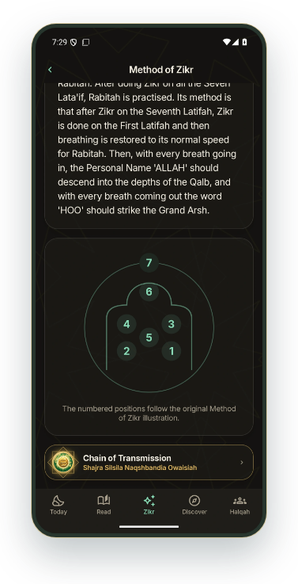
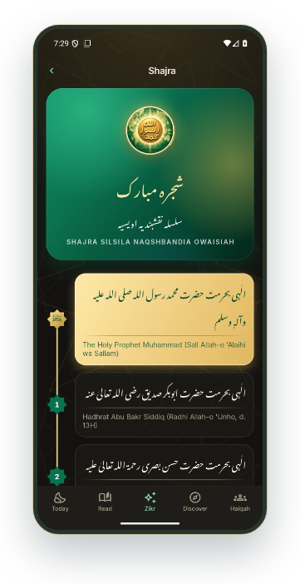
DARUL IRFAN
ZIKR
ANDROID APP PREVIEW
Guidance beside the
practice
عمل کے ساتھ رہنمائی بھی
The Method of Zikr and Shajra are close to the places where you
practise.
طریقۂ ذکر اور شجرہ، ذاتی ذکر اور تسبیح کے ساتھ فوراً کھولیں۔
Read the Method of Zikr
↗
طریقۂ ذکر پڑھیں
See the seven Lataif diagram
↗
سات لطائف کا خاکہ دیکھیں
Open the Shajra
↗
شجرہ کھولیں
Method of Zikr · Seven Lataif
Shajra · Chain of transmission
SILSILA NAQSHBANDIA OWAISIAH
App map
All features
20 / 65
‹
›
Notes:
Guidance beside the practice
عمل کے ساتھ رہنمائی بھی
The Method of Zikr and Shajra are close to the places where you practise.
طریقۂ ذکر اور شجرہ، ذاتی ذکر اور تسبیح کے ساتھ فوراً کھولیں۔
Interactive screen previews: keep Darul-Irfan-Interactive-Showcase-v5.html beside the PowerPoint. Open hyperlinks in Slide Show mode.
Android screenshots captured 4 November 2026 from local debug build 21 including the in-progress interface changes (27b5147 and the later 3a944a9 speech update). Administration and live Zikr screens were captured on 5 November 2026 signed in as a super admin, with a Test Zikr on Canada (nobody notified), and the Silsila Markaz screens; member names, emails and places are blurred. All included screen images were captured in this pass.
iOS counterpart checked against local i-content source. No historical iOS screenshots are used.
Original artwork: DarulIrfanApp/Resources/Images/Assets.xcassets/BrandEmblem.imageset and islamic-pattern.imageset.

Slide 21
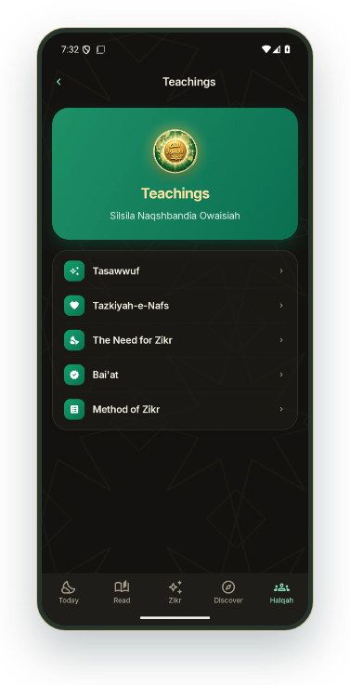
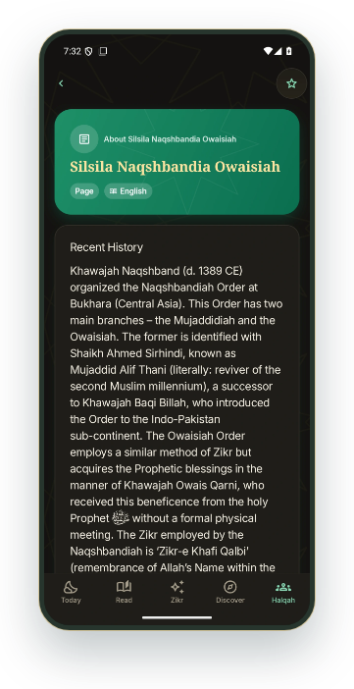
DARUL IRFAN
HALQAH
ANDROID APP PREVIEW
Know the Silsila
سلسلے کا تعارف اور تعلیمات
Explore the history, the Sheikhs, Tasawwuf, Tazkiyah and the
purpose of Zikr.
سلسلے کی تاریخ، مشائخ، تصوف، تزکیہ اور ذکر کی ضرورت کے بارے میں پڑھیں۔
About the Silsila
↗
سلسلے کا تعارف
Browse the teachings
↗
تعلیمات کی فہرست دیکھیں
Read about Tasawwuf
↗
تصوف کے بارے میں پڑھیں
The interface is bilingual. Individual publications retain their available content languages.
Teachings · Subjects
About the Silsila
SILSILA NAQSHBANDIA OWAISIAH
App map
All features
21 / 65
‹
›
Notes:
Know the Silsila
سلسلے کا تعارف اور تعلیمات
Explore the history, the Sheikhs, Tasawwuf, Tazkiyah and the purpose of Zikr.
سلسلے کی تاریخ، مشائخ، تصوف، تزکیہ اور ذکر کی ضرورت کے بارے میں پڑھیں۔
The interface is bilingual. Individual publications retain their available content languages.
Interactive screen previews: keep Darul-Irfan-Interactive-Showcase-v5.html beside the PowerPoint. Open hyperlinks in Slide Show mode.
Android screenshots captured 4 November 2026 from local debug build 21 including the in-progress interface changes (27b5147 and the later 3a944a9 speech update). Administration and live Zikr screens were captured on 5 November 2026 signed in as a super admin, with a Test Zikr on Canada (nobody notified), and the Silsila Markaz screens; member names, emails and places are blurred. All included screen images were captured in this pass.
iOS counterpart checked against local i-content source. No historical iOS screenshots are used.
Original artwork: DarulIrfanApp/Resources/Images/Assets.xcassets/BrandEmblem.imageset and islamic-pattern.imageset.

Slide 22
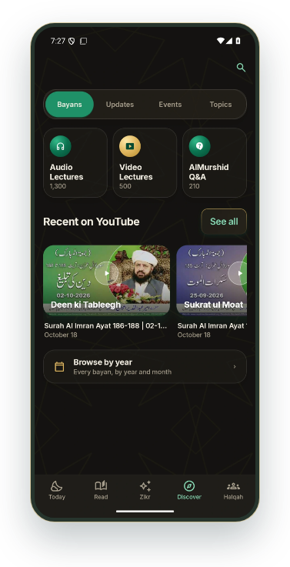
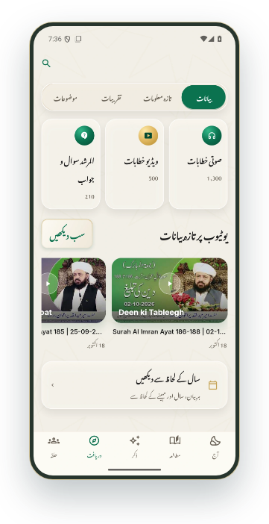
DARUL IRFAN
DISCOVER
ANDROID APP PREVIEW
A bayan for your next
moment
اپنی فرصت میں آڈیو بیان سنیں
Find recent and archived audio or video, then continue listening
when it suits you.
نئے اور پرانے آڈیو یا ویڈیو بیانات تلاش کریں اور اپنی سہولت سے سنیں۔
Open the bayan library
↗
بیانات کی فہرست کھولیں
Browse in Urdu
↗
اردو میں بیانات دیکھیں
Explore speaker, date and archive options
مقرر، تاریخ اور پرانے بیانات کے انتخاب دیکھیں
Bayans · Audio & video
Bayans · Urdu interface
SILSILA NAQSHBANDIA OWAISIAH
App map
All features
22 / 65
‹
›
Notes:
A bayan for your next moment
اپنی فرصت میں آڈیو بیان سنیں
Find recent and archived audio or video, then continue listening when it suits you.
نئے اور پرانے آڈیو یا ویڈیو بیانات تلاش کریں اور اپنی سہولت سے سنیں۔
Interactive screen previews: keep Darul-Irfan-Interactive-Showcase-v5.html beside the PowerPoint. Open hyperlinks in Slide Show mode.
Android screenshots captured 4 November 2026 from local debug build 21 including the in-progress interface changes (27b5147 and the later 3a944a9 speech update). Administration and live Zikr screens were captured on 5 November 2026 signed in as a super admin, with a Test Zikr on Canada (nobody notified), and the Silsila Markaz screens; member names, emails and places are blurred. All included screen images were captured in this pass.
iOS counterpart checked against local i-content source. No historical iOS screenshots are used.
Original artwork: DarulIrfanApp/Resources/Images/Assets.xcassets/BrandEmblem.imageset and islamic-pattern.imageset.

Slide 23
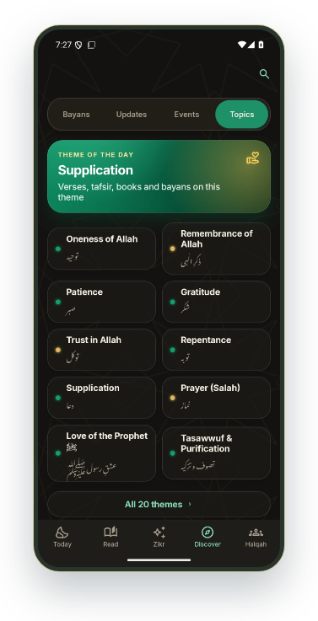
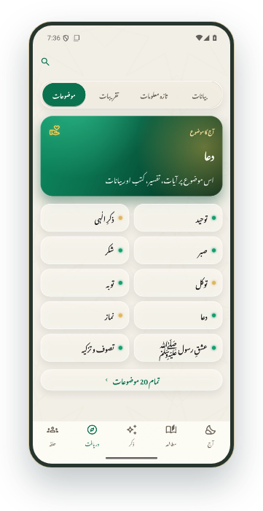
DARUL IRFAN
DISCOVER
ANDROID APP PREVIEW
Follow a subject further
کسی موضوع کو مزید سمجھیں
Topic pages bring related ayat, books and bayans together
around a subject.
موضوع کے صفحے پر متعلقہ آیات، کتابیں اور بیانات ایک ساتھ ملتے ہیں۔
Browse the topic collection
↗
موضوعات کی فہرست دیکھیں
Explore topics in Urdu
↗
اردو میں موضوعات دیکھیں
Move into the linked source material
متعلقہ اصل مواد کھولیں
Topics · Browse
Topics · Urdu interface
SILSILA NAQSHBANDIA OWAISIAH
App map
All features
23 / 65
‹
›
Notes:
Follow a subject further
کسی موضوع کو مزید سمجھیں
Topic pages bring related ayat, books and bayans together around a subject.
موضوع کے صفحے پر متعلقہ آیات، کتابیں اور بیانات ایک ساتھ ملتے ہیں۔
Interactive screen previews: keep Darul-Irfan-Interactive-Showcase-v5.html beside the PowerPoint. Open hyperlinks in Slide Show mode.
Android screenshots captured 4 November 2026 from local debug build 21 including the in-progress interface changes (27b5147 and the later 3a944a9 speech update). Administration and live Zikr screens were captured on 5 November 2026 signed in as a super admin, with a Test Zikr on Canada (nobody notified), and the Silsila Markaz screens; member names, emails and places are blurred. All included screen images were captured in this pass.
iOS counterpart checked against local i-content source. No historical iOS screenshots are used.
Original artwork: DarulIrfanApp/Resources/Images/Assets.xcassets/BrandEmblem.imageset and islamic-pattern.imageset.

Slide 24
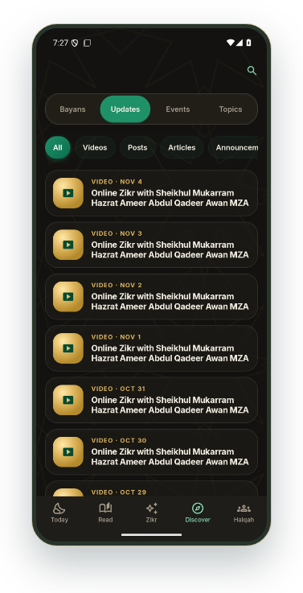
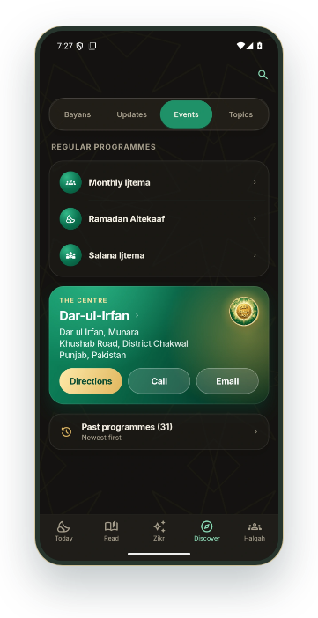
DARUL IRFAN
DISCOVER + HALQAH
ANDROID APP PREVIEW
Stay connected to the
community
سلسلے کی خبروں اور حلقوں سے جڑے رہیں
Official updates, events and member Halqahs keep information
and participation close together.
اہم خبریں، تقریبات اور ممبر حلقے ایک ہی ایپ میں دیکھیں۔
Official news and daily media
↗
اہم خبریں اور روزانہ کا مواد
Upcoming and past events
↗
آنے والی اور پچھلی تقریبات
Member Halqah access
↗
ممبر حلقے میں شامل ہوں
Private Halqahs use invitations or membership. Session and administration features depend on your role.
Official updates
Events · Calendar
SILSILA NAQSHBANDIA OWAISIAH
App map
All features
24 / 65
‹
›
Notes:
Stay connected to the community
سلسلے کی خبروں اور حلقوں سے جڑے رہیں
Official updates, events and member Halqahs keep information and participation close together.
اہم خبریں، تقریبات اور ممبر حلقے ایک ہی ایپ میں دیکھیں۔
Private Halqahs use invitations or membership. Session and administration features depend on your role.
Interactive screen previews: keep Darul-Irfan-Interactive-Showcase-v5.html beside the PowerPoint. Open hyperlinks in Slide Show mode.
Android screenshots captured 4 November 2026 from local debug build 21 including the in-progress interface changes (27b5147 and the later 3a944a9 speech update). Administration and live Zikr screens were captured on 5 November 2026 signed in as a super admin, with a Test Zikr on Canada (nobody notified), and the Silsila Markaz screens; member names, emails and places are blurred. All included screen images were captured in this pass.
iOS counterpart checked against local i-content source. No historical iOS screenshots are used.
Original artwork: DarulIrfanApp/Resources/Images/Assets.xcassets/BrandEmblem.imageset and islamic-pattern.imageset.

Slide 25

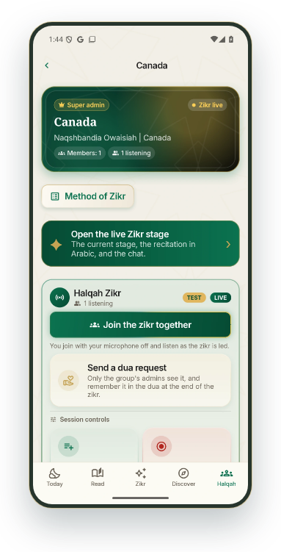
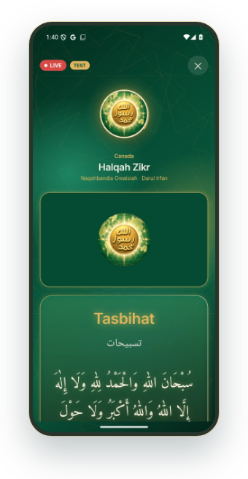
DARUL IRFAN
AUTOMATION
ANDROID APP PREVIEW
From Paltalk to every
screen, by itself
پالٹاک سے ہر اسکرین تک، خود بخود
When Hazrat ji begins on Paltalk, the Zikr starts in the app,
members are told, the websites go live and the stream picture is
ready.
جب حضرت جی پالٹاک پر شروع فرماتے ہیں تو ایپ میں ذکر شروع ہو جاتا ہے، ممبروں کو اطلاع جاتی ہے، ویب سائٹس لائیو ہو جاتی ہیں اور نشریات کی تصویر تیار ہوتی ہے۔
No one types or taps Start
↗
نہ کچھ لکھنا، نہ شروع کا بٹن
Paltalk's host cues reach the stage
↗
پالٹاک کے میزبان کے اشارے اسٹیج تک
The Dua shows, and the session closes five minutes later
↗
دعا دکھتی ہے، اور پانچ منٹ بعد نشست ختم
Live Zikr card
Stage · Tasbihat
SILSILA NAQSHBANDIA OWAISIAH
App map
All features
25 / 65
‹
›
Notes:
From Paltalk to every screen, by itself
پالٹاک سے ہر اسکرین تک، خود بخود
When Hazrat ji begins on Paltalk, the Zikr starts in the app, members are told, the websites go live and the stream picture is ready.
جب حضرت جی پالٹاک پر شروع فرماتے ہیں تو ایپ میں ذکر شروع ہو جاتا ہے، ممبروں کو اطلاع جاتی ہے، ویب سائٹس لائیو ہو جاتی ہیں اور نشریات کی تصویر تیار ہوتی ہے۔
Interactive screen previews: keep Darul-Irfan-Interactive-Showcase-v5.html beside the PowerPoint. Open hyperlinks in Slide Show mode.
Android screenshots captured 4 November 2026 from local debug build 21 including the in-progress interface changes (27b5147 and the later 3a944a9 speech update). Administration and live Zikr screens were captured on 5 November 2026 signed in as a super admin, with a Test Zikr on Canada (nobody notified), and the Silsila Markaz screens; member names, emails and places are blurred. All included screen images were captured in this pass.
iOS counterpart checked against local i-content source. No historical iOS screenshots are used.
Original artwork: DarulIrfanApp/Resources/Images/Assets.xcassets/BrandEmblem.imageset and islamic-pattern.imageset.

Slide 26
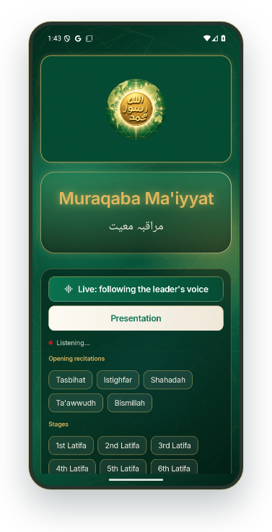
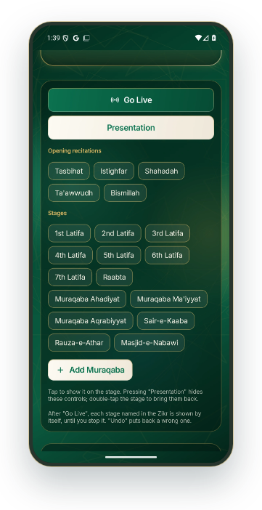
DARUL IRFAN
AUTOMATION
ANDROID APP PREVIEW
The stage follows the voice
اسٹیج آواز کے ساتھ چلتا ہے
Go Live listens and moves the stage as each recitation, Latifa and
Muraqaba is called. If the sound is unclear, one tap does it.
گو لائیو سنتا ہے اور ہر تسبیح، لطیفہ اور مراقبہ کے ساتھ اسٹیج بدلتا ہے۔ اگر آواز صاف نہ ہو تو ایک ٹیپ کافی ہے۔
Hands-free for the whole session
↗
پوری نشست میں ہاتھ لگائے بغیر
A tap is the backup, never the routine
↗
ٹیپ صرف متبادل ہے، معمول نہیں
Undo puts back a wrong stage at once
↗
غلط مرحلہ فوراً واپس
Go Live · Following the voice
Leader's stage controls
SILSILA NAQSHBANDIA OWAISIAH
App map
All features
26 / 65
‹
›
Notes:
The stage follows the voice
اسٹیج آواز کے ساتھ چلتا ہے
Go Live listens and moves the stage as each recitation, Latifa and Muraqaba is called. If the sound is unclear, one tap does it.
گو لائیو سنتا ہے اور ہر تسبیح، لطیفہ اور مراقبہ کے ساتھ اسٹیج بدلتا ہے۔ اگر آواز صاف نہ ہو تو ایک ٹیپ کافی ہے۔
Interactive screen previews: keep Darul-Irfan-Interactive-Showcase-v5.html beside the PowerPoint. Open hyperlinks in Slide Show mode.
Android screenshots captured 4 November 2026 from local debug build 21 including the in-progress interface changes (27b5147 and the later 3a944a9 speech update). Administration and live Zikr screens were captured on 5 November 2026 signed in as a super admin, with a Test Zikr on Canada (nobody notified), and the Silsila Markaz screens; member names, emails and places are blurred. All included screen images were captured in this pass.
iOS counterpart checked against local i-content source. No historical iOS screenshots are used.
Original artwork: DarulIrfanApp/Resources/Images/Assets.xcassets/BrandEmblem.imageset and islamic-pattern.imageset.

Slide 27

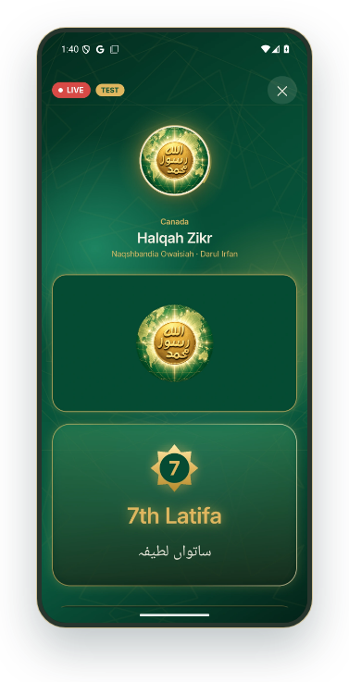
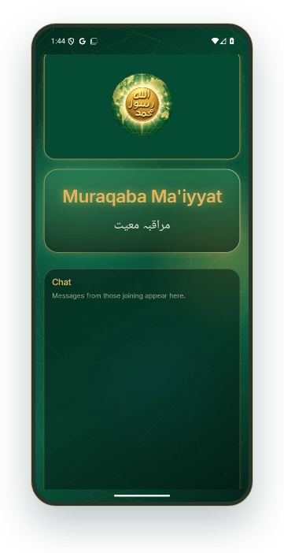
DARUL IRFAN
AUTOMATION
ANDROID APP PREVIEW
Better than a chat-window
stream
چیٹ ونڈو کی نشریات سے بہتر
Instead of a chat window, viewers see the stage itself: the
emblem or Hazrat ji's photograph, the current Latifa in light, the
Arabic recitations.
چیٹ ونڈو کی جگہ دیکھنے والے اسٹیج دیکھتے ہیں: نشان یا حضرت جی کی تصویر، روشنی میں موجودہ لطیفہ، اور عربی تسبیحات۔
One full-screen picture, made for YouTube and Facebook
↗
یوٹیوب اور فیس بک کے لیے ایک مکمل تصویر
Each Latifa numbered, each Muraqaba named
↗
ہر لطیفہ نمبر کے ساتھ، ہر مراقبہ نام کے ساتھ
The same stage in the app and on the websites
↗
یہی اسٹیج ایپ اور ویب سائٹس پر
Stage · 7th Latifa
Presentation view
SILSILA NAQSHBANDIA OWAISIAH
App map
All features
27 / 65
‹
›
Notes:
Better than a chat-window stream
چیٹ ونڈو کی نشریات سے بہتر
Instead of a chat window, viewers see the stage itself: the emblem or Hazrat ji's photograph, the current Latifa in light, the Arabic recitations.
چیٹ ونڈو کی جگہ دیکھنے والے اسٹیج دیکھتے ہیں: نشان یا حضرت جی کی تصویر، روشنی میں موجودہ لطیفہ، اور عربی تسبیحات۔
Interactive screen previews: keep Darul-Irfan-Interactive-Showcase-v5.html beside the PowerPoint. Open hyperlinks in Slide Show mode.
Android screenshots captured 4 November 2026 from local debug build 21 including the in-progress interface changes (27b5147 and the later 3a944a9 speech update). Administration and live Zikr screens were captured on 5 November 2026 signed in as a super admin, with a Test Zikr on Canada (nobody notified), and the Silsila Markaz screens; member names, emails and places are blurred. All included screen images were captured in this pass.
iOS counterpart checked against local i-content source. No historical iOS screenshots are used.
Original artwork: DarulIrfanApp/Resources/Images/Assets.xcassets/BrandEmblem.imageset and islamic-pattern.imageset.

Slide 28
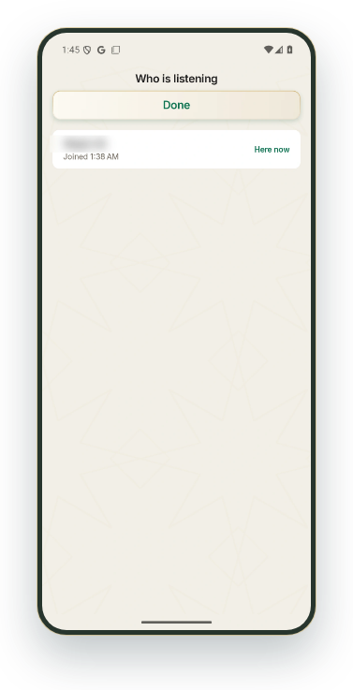
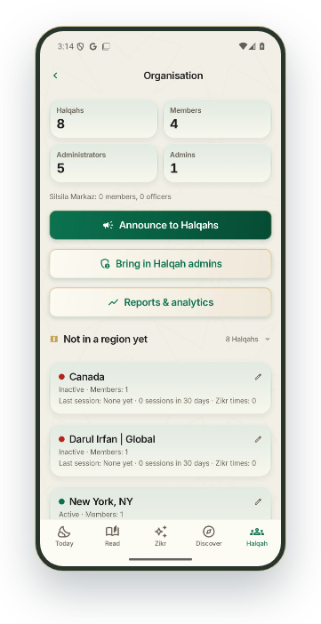
DARUL IRFAN
AUTOMATION
ANDROID APP PREVIEW
Admins monitor; the
system does the work
ایڈمن نگرانی کریں؛ کام نظام کرے
The manual steps are gone. Admins watch who is listening, see
what needs attention, and step in only when needed.
دستی مراحل ختم ہو گئے۔ ایڈمن دیکھتے ہیں کون سن رہا ہے، کس چیز پر توجہ چاہیے، اور صرف ضرورت پر مداخلت کرتے ہیں۔
Who is listening, live
↗
کون سن رہا ہے، لائیو
Every Halqah on air, at a glance
↗
ہر لائیو حلقہ ایک نظر میں
A morning summary of yesterday on the phone
↗
فون پر گزشتہ دن کا صبح کا خلاصہ
Who is listening
Organisation
SILSILA NAQSHBANDIA OWAISIAH
App map
All features
28 / 65
‹
›
Notes:
Admins monitor; the system does the work
ایڈمن نگرانی کریں؛ کام نظام کرے
The manual steps are gone. Admins watch who is listening, see what needs attention, and step in only when needed.
دستی مراحل ختم ہو گئے۔ ایڈمن دیکھتے ہیں کون سن رہا ہے، کس چیز پر توجہ چاہیے، اور صرف ضرورت پر مداخلت کرتے ہیں۔
Interactive screen previews: keep Darul-Irfan-Interactive-Showcase-v5.html beside the PowerPoint. Open hyperlinks in Slide Show mode.
Android screenshots captured 4 November 2026 from local debug build 21 including the in-progress interface changes (27b5147 and the later 3a944a9 speech update). Administration and live Zikr screens were captured on 5 November 2026 signed in as a super admin, with a Test Zikr on Canada (nobody notified), and the Silsila Markaz screens; member names, emails and places are blurred. All included screen images were captured in this pass.
iOS counterpart checked against local i-content source. No historical iOS screenshots are used.
Original artwork: DarulIrfanApp/Resources/Images/Assets.xcassets/BrandEmblem.imageset and islamic-pattern.imageset.

Slide 29


DARUL IRFAN
ADMINISTRATION
ANDROID APP PREVIEW
Who looks after what
کون کیا سنبھالتا ہے
Super admins look after every Halqah. Each Halqah has its own
Administrators and Admins.
سپر ایڈمن تمام حلقوں کی نگرانی کرتے ہیں۔ ہر حلقے کے اپنے منتظم اور ایڈمن ہیں۔
Super admin: every Halqah and every person
↗
سپر ایڈمن: ہر حلقہ اور ہر فرد
Administrator and Admin: their own Halqah
↗
منتظم اور ایڈمن: اپنا حلقہ
Members and website visitors join and follow
ممبر اور ویب سائٹ کے مہمان شامل ہو کر ساتھ چلتے ہیں
Super admin · Dashboard
Halqah admin
SILSILA NAQSHBANDIA OWAISIAH
App map
All features
29 / 65
‹
›
Notes:
Who looks after what
کون کیا سنبھالتا ہے
Super admins look after every Halqah. Each Halqah has its own Administrators and Admins.
سپر ایڈمن تمام حلقوں کی نگرانی کرتے ہیں۔ ہر حلقے کے اپنے منتظم اور ایڈمن ہیں۔
Interactive screen previews: keep Darul-Irfan-Interactive-Showcase-v5.html beside the PowerPoint. Open hyperlinks in Slide Show mode.
Android screenshots captured 4 November 2026 from local debug build 21 including the in-progress interface changes (27b5147 and the later 3a944a9 speech update). Administration and live Zikr screens were captured on 5 November 2026 signed in as a super admin, with a Test Zikr on Canada (nobody notified), and the Silsila Markaz screens; member names, emails and places are blurred. All included screen images were captured in this pass.
iOS counterpart checked against local i-content source. No historical iOS screenshots are used.
Original artwork: DarulIrfanApp/Resources/Images/Assets.xcassets/BrandEmblem.imageset and islamic-pattern.imageset.

Slide 30


DARUL IRFAN
ADMINISTRATION
ANDROID APP PREVIEW
Make and look after
Halqahs
حلقے بنائیں اور سنبھالیں
A super admin opens a new Halqah, renames or retires it, and
sees which Halqahs are live.
سپر ایڈمن نیا حلقہ بناتے، نام بدلتے یا ختم کرتے ہیں، اور دیکھتے ہیں کہ کون سا حلقہ لائیو ہے۔
Halqahs, people and live sessions at a glance
↗
حلقے، افراد اور لائیو نشستیں ایک نظر میں
Rename, describe or retire a Halqah
↗
حلقے کا نام اور تعارف بدلیں یا ختم کریں
A retired Halqah keeps its people and history
ختم شدہ حلقے کے افراد اور ریکارڈ محفوظ رہتے ہیں
Super admin · Halqahs
Rename or retire a Halqah
SILSILA NAQSHBANDIA OWAISIAH
App map
All features
30 / 65
‹
›
Notes:
Make and look after Halqahs
حلقے بنائیں اور سنبھالیں
A super admin opens a new Halqah, renames or retires it, and sees which Halqahs are live.
سپر ایڈمن نیا حلقہ بناتے، نام بدلتے یا ختم کرتے ہیں، اور دیکھتے ہیں کہ کون سا حلقہ لائیو ہے۔
Interactive screen previews: keep Darul-Irfan-Interactive-Showcase-v5.html beside the PowerPoint. Open hyperlinks in Slide Show mode.
Android screenshots captured 4 November 2026 from local debug build 21 including the in-progress interface changes (27b5147 and the later 3a944a9 speech update). Administration and live Zikr screens were captured on 5 November 2026 signed in as a super admin, with a Test Zikr on Canada (nobody notified), and the Silsila Markaz screens; member names, emails and places are blurred. All included screen images were captured in this pass.
iOS counterpart checked against local i-content source. No historical iOS screenshots are used.
Original artwork: DarulIrfanApp/Resources/Images/Assets.xcassets/BrandEmblem.imageset and islamic-pattern.imageset.

Slide 31



DARUL IRFAN
ADMINISTRATION
ANDROID APP PREVIEW
Everyone, in the right place
ہر فرد، اپنی صحیح جگہ
Find anyone who has signed in and place them in any Halqah as
Administrator, Admin or member.
سائن اِن کرنے والے کسی بھی فرد کو تلاش کر کے کسی بھی حلقے میں منتظم، ایڈمن یا ممبر بنائیں۔
Search by name, email or Halqah
↗
نام، ای میل یا حلقے سے تلاش کریں
Change a role or remove from a Halqah
↗
کردار بدلیں یا حلقے سے ہٹائیں
Add anyone to another Halqah
↗
کسی کو بھی دوسرے حلقے میں شامل کریں
Member names, emails and places are blurred.
Everyone who has signed in
Change a role
SILSILA NAQSHBANDIA OWAISIAH
App map
All features
31 / 65
‹
›
Notes:
Everyone, in the right place
ہر فرد، اپنی صحیح جگہ
Find anyone who has signed in and place them in any Halqah as Administrator, Admin or member.
سائن اِن کرنے والے کسی بھی فرد کو تلاش کر کے کسی بھی حلقے میں منتظم، ایڈمن یا ممبر بنائیں۔
Member names, emails and places are blurred.
Interactive screen previews: keep Darul-Irfan-Interactive-Showcase-v5.html beside the PowerPoint. Open hyperlinks in Slide Show mode.
Android screenshots captured 4 November 2026 from local debug build 21 including the in-progress interface changes (27b5147 and the later 3a944a9 speech update). Administration and live Zikr screens were captured on 5 November 2026 signed in as a super admin, with a Test Zikr on Canada (nobody notified), and the Silsila Markaz screens; member names, emails and places are blurred. All included screen images were captured in this pass.
iOS counterpart checked against local i-content source. No historical iOS screenshots are used.
Original artwork: DarulIrfanApp/Resources/Images/Assets.xcassets/BrandEmblem.imageset and islamic-pattern.imageset.

Slide 32


DARUL IRFAN
ADMINISTRATION
ANDROID APP PREVIEW
Today's pictures
آج کی تصاویر
Publish the day's Ayah, Hadith, Aqwal-e-Sheikh or announcement
picture, or forward it from WhatsApp.
دن کی آیت، حدیث، اقوالِ شیخ یا اعلان کی تصویر شائع کریں، یا واٹس ایپ سے بھیجیں۔
Choose its place and its day
↗
اس کی جگہ اور دن منتخب کریں
Optionally open it over the Today page
↗
چاہیں تو آج کے صفحے پر خود کھلے
WhatsApp pictures wait as drafts
↗
واٹس ایپ کی تصاویر مسودے میں منتظر رہتی ہیں
Today's pictures
Today's picture · Where and when
SILSILA NAQSHBANDIA OWAISIAH
App map
All features
32 / 65
‹
›
Notes:
Today's pictures
آج کی تصاویر
Publish the day's Ayah, Hadith, Aqwal-e-Sheikh or announcement picture, or forward it from WhatsApp.
دن کی آیت، حدیث، اقوالِ شیخ یا اعلان کی تصویر شائع کریں، یا واٹس ایپ سے بھیجیں۔
Interactive screen previews: keep Darul-Irfan-Interactive-Showcase-v5.html beside the PowerPoint. Open hyperlinks in Slide Show mode.
Android screenshots captured 4 November 2026 from local debug build 21 including the in-progress interface changes (27b5147 and the later 3a944a9 speech update). Administration and live Zikr screens were captured on 5 November 2026 signed in as a super admin, with a Test Zikr on Canada (nobody notified), and the Silsila Markaz screens; member names, emails and places are blurred. All included screen images were captured in this pass.
iOS counterpart checked against local i-content source. No historical iOS screenshots are used.
Original artwork: DarulIrfanApp/Resources/Images/Assets.xcassets/BrandEmblem.imageset and islamic-pattern.imageset.

Slide 33


DARUL IRFAN
HALQAH ADMIN
ANDROID APP PREVIEW
Running a Halqah
حلقے کا انتظام
One place for people, posts, meetings, Zikr times, dua requests
and past sessions.
افراد، پوسٹس، میٹنگز، ذکر کے اوقات، دعا کی درخواستیں اور پچھلی نشستیں، سب ایک جگہ۔
Add people by email, phone or code
↗
ای میل، فون یا کوڈ سے افراد شامل کریں
Make Admins; withdraw unused invitations
↗
ایڈمن بنائیں؛ غیر استعمال شدہ دعوت واپس لیں
Invitation codes sent from your own phone
↗
دعوتی کوڈ آپ کے اپنے فون سے
Member names, emails and places are blurred.
Halqah · Admin view
Members and invitations
SILSILA NAQSHBANDIA OWAISIAH
App map
All features
33 / 65
‹
›
Notes:
Running a Halqah
حلقے کا انتظام
One place for people, posts, meetings, Zikr times, dua requests and past sessions.
افراد، پوسٹس، میٹنگز، ذکر کے اوقات، دعا کی درخواستیں اور پچھلی نشستیں، سب ایک جگہ۔
Member names, emails and places are blurred.
Interactive screen previews: keep Darul-Irfan-Interactive-Showcase-v5.html beside the PowerPoint. Open hyperlinks in Slide Show mode.
Android screenshots captured 4 November 2026 from local debug build 21 including the in-progress interface changes (27b5147 and the later 3a944a9 speech update). Administration and live Zikr screens were captured on 5 November 2026 signed in as a super admin, with a Test Zikr on Canada (nobody notified), and the Silsila Markaz screens; member names, emails and places are blurred. All included screen images were captured in this pass.
iOS counterpart checked against local i-content source. No historical iOS screenshots are used.
Original artwork: DarulIrfanApp/Resources/Images/Assets.xcassets/BrandEmblem.imageset and islamic-pattern.imageset.

Slide 34


DARUL IRFAN
HALQAH ADMIN
ANDROID APP PREVIEW
Posts, meetings and Zikr
times
پوسٹس، میٹنگز اور ذکر کے اوقات
Share news with pictures and videos, plan a meeting, and set Zikr
times that can start by themselves.
تصاویر اور ویڈیوز کے ساتھ خبر دیں، میٹنگ رکھیں، اور ذکر کے اوقات مقرر کریں جو خود شروع ہو سکیں۔
Paste from WhatsApp; up to 10 photos or videos
↗
واٹس ایپ سے پیسٹ کریں؛ 10 تک تصاویر یا ویڈیوز
Meetings in each member's own time
↗
ہر ممبر کے اپنے وقت میں میٹنگ
At a time, after Isha or before Fajr
↗
مقررہ وقت، عشاء کے بعد یا فجر سے پہلے
New post
Add a Zikr time
SILSILA NAQSHBANDIA OWAISIAH
App map
All features
34 / 65
‹
›
Notes:
Posts, meetings and Zikr times
پوسٹس، میٹنگز اور ذکر کے اوقات
Share news with pictures and videos, plan a meeting, and set Zikr times that can start by themselves.
تصاویر اور ویڈیوز کے ساتھ خبر دیں، میٹنگ رکھیں، اور ذکر کے اوقات مقرر کریں جو خود شروع ہو سکیں۔
Interactive screen previews: keep Darul-Irfan-Interactive-Showcase-v5.html beside the PowerPoint. Open hyperlinks in Slide Show mode.
Android screenshots captured 4 November 2026 from local debug build 21 including the in-progress interface changes (27b5147 and the later 3a944a9 speech update). Administration and live Zikr screens were captured on 5 November 2026 signed in as a super admin, with a Test Zikr on Canada (nobody notified), and the Silsila Markaz screens; member names, emails and places are blurred. All included screen images were captured in this pass.
iOS counterpart checked against local i-content source. No historical iOS screenshots are used.
Original artwork: DarulIrfanApp/Resources/Images/Assets.xcassets/BrandEmblem.imageset and islamic-pattern.imageset.

Slide 35


DARUL IRFAN
LIVE ZIKR
ANDROID APP PREVIEW
Go live, or test first
لائیو شروع کریں، یا پہلے آزمائیں
Choose how the group joins: led live, a YouTube Zikr or a
recording. Test only notifies nobody.
منتخب کریں کہ حلقہ کیسے شامل ہو: براہِ راست، یوٹیوب یا ریکارڈنگ۔ آزمائش میں کسی کو اطلاع نہیں جاتی۔
Lead live, YouTube or a recording
↗
براہِ راست، یوٹیوب یا ریکارڈنگ
Past Zikr from the channel, played together
↗
چینل کا پچھلا ذکر، سب ایک ساتھ
Test only: only admins see it
↗
صرف آزمائش: صرف ایڈمن دیکھتے ہیں
Go live · Lead live
Go live · Test only
SILSILA NAQSHBANDIA OWAISIAH
App map
All features
35 / 65
‹
›
Notes:
Go live, or test first
لائیو شروع کریں، یا پہلے آزمائیں
Choose how the group joins: led live, a YouTube Zikr or a recording. Test only notifies nobody.
منتخب کریں کہ حلقہ کیسے شامل ہو: براہِ راست، یوٹیوب یا ریکارڈنگ۔ آزمائش میں کسی کو اطلاع نہیں جاتی۔
Interactive screen previews: keep Darul-Irfan-Interactive-Showcase-v5.html beside the PowerPoint. Open hyperlinks in Slide Show mode.
Android screenshots captured 4 November 2026 from local debug build 21 including the in-progress interface changes (27b5147 and the later 3a944a9 speech update). Administration and live Zikr screens were captured on 5 November 2026 signed in as a super admin, with a Test Zikr on Canada (nobody notified), and the Silsila Markaz screens; member names, emails and places are blurred. All included screen images were captured in this pass.
iOS counterpart checked against local i-content source. No historical iOS screenshots are used.
Original artwork: DarulIrfanApp/Resources/Images/Assets.xcassets/BrandEmblem.imageset and islamic-pattern.imageset.

Slide 36
DARUL IRFAN
LIVE ZIKR
ANDROID APP PREVIEW
Leading the stage
اسٹیج کی رہنمائی
Hazrat ji's admins and each Halqah's leader tap each stage, or tap
Go Live and it follows the voice.
حضرت جی کے ایڈمن اور ہر حلقے کے رہنما ہر مرحلہ دبائیں، یا گو لائیو دبائیں اور اسٹیج آواز کے ساتھ بدلے۔
Recitations, seven Lataif, Raabta and Muraqabat
↗
تسبیحات، سات لطائف، رابطہ اور مراقبات
Go Live: hands-free, with Undo
↗
گو لائیو: ہاتھ لگائے بغیر، واپسی کے اختیار کے ساتھ
Presentation hides the controls for streaming
↗
پیشکش کا منظر نشریات کے لیے بٹن چھپا دیتا ہے
Go Live needs microphone permission on the leading phone. Our Sheikh admins see Start Daily Zikr.
Go Live · Following the voice
Leader's stage controls
SILSILA NAQSHBANDIA OWAISIAH
App map
All features
36 / 65
‹
›
Notes:
Leading the stage
اسٹیج کی رہنمائی
Hazrat ji's admins and each Halqah's leader tap each stage, or tap Go Live and it follows the voice.
حضرت جی کے ایڈمن اور ہر حلقے کے رہنما ہر مرحلہ دبائیں، یا گو لائیو دبائیں اور اسٹیج آواز کے ساتھ بدلے۔
Go Live needs microphone permission on the leading phone. Our Sheikh admins see Start Daily Zikr.
Interactive screen previews: keep Darul-Irfan-Interactive-Showcase-v5.html beside the PowerPoint. Open hyperlinks in Slide Show mode.
Android screenshots captured 4 November 2026 from local debug build 21 including the in-progress interface changes (27b5147 and the later 3a944a9 speech update). Administration and live Zikr screens were captured on 5 November 2026 signed in as a super admin, with a Test Zikr on Canada (nobody notified), and the Silsila Markaz screens; member names, emails and places are blurred. All included screen images were captured in this pass.
iOS counterpart checked against local i-content source. No historical iOS screenshots are used.
Original artwork: DarulIrfanApp/Resources/Images/Assets.xcassets/BrandEmblem.imageset and islamic-pattern.imageset.

Slide 37


DARUL IRFAN
LIVE ZIKR
ANDROID APP PREVIEW
What everyone sees
سب کیا دیکھتے ہیں
The current stage fills the screen with light: Arabic recitations,
numbered Lataif, English with Urdu.
موجودہ مرحلہ روشنی کے ساتھ پوری اسکرین پر: عربی تسبیحات، نمبر والے لطائف، انگریزی کے ساتھ اردو۔
Tasbihat in Arabic
↗
تسبیحات عربی میں
Each Latifa, up to the seventh
↗
ہر لطیفہ، ساتویں تک
Each Muraqaba, up to Masjid-e-Nabawi
↗
ہر مراقبہ، مسجدِ نبوی تک
On Our Sheikh the stage shows Hazrat ji's photograph; other Halqahs show the Silsila emblem.
Stage · Tasbihat
Stage · 7th Latifa
SILSILA NAQSHBANDIA OWAISIAH
App map
All features
37 / 65
‹
›
Notes:
What everyone sees
سب کیا دیکھتے ہیں
The current stage fills the screen with light: Arabic recitations, numbered Lataif, English with Urdu.
موجودہ مرحلہ روشنی کے ساتھ پوری اسکرین پر: عربی تسبیحات، نمبر والے لطائف، انگریزی کے ساتھ اردو۔
On Our Sheikh the stage shows Hazrat ji's photograph; other Halqahs show the Silsila emblem.
Interactive screen previews: keep Darul-Irfan-Interactive-Showcase-v5.html beside the PowerPoint. Open hyperlinks in Slide Show mode.
Android screenshots captured 4 November 2026 from local debug build 21 including the in-progress interface changes (27b5147 and the later 3a944a9 speech update). Administration and live Zikr screens were captured on 5 November 2026 signed in as a super admin, with a Test Zikr on Canada (nobody notified), and the Silsila Markaz screens; member names, emails and places are blurred. All included screen images were captured in this pass.
iOS counterpart checked against local i-content source. No historical iOS screenshots are used.
Original artwork: DarulIrfanApp/Resources/Images/Assets.xcassets/BrandEmblem.imageset and islamic-pattern.imageset.

Slide 38


DARUL IRFAN
LIVE ZIKR
ANDROID APP PREVIEW
Muraqabat, chat and
removals
مراقبات، گفتگو اور حذف
Leaders add a Muraqaba on the spot. Admins remove anything
from the stage or the chat.
رہنما موقع پر مراقبہ شامل کرتے ہیں۔ ایڈمن اسٹیج یا گفتگو سے کچھ بھی ہٹا سکتے ہیں۔
Add a Muraqaba with its Urdu name
↗
اردو نام کے ساتھ مراقبہ شامل کریں
Remove any stage announcement
↗
کوئی بھی اسٹیج اعلان ہٹائیں
Press and hold a message to remove it
↗
پیغام کو دبا کر رکھیں اور ہٹائیں
Members send ready-made messages such as Ameen and JazakAllahu khairan; leaders may type.
Add Muraqaba
Remove a message
SILSILA NAQSHBANDIA OWAISIAH
App map
All features
38 / 65
‹
›
Notes:
Muraqabat, chat and removals
مراقبات، گفتگو اور حذف
Leaders add a Muraqaba on the spot. Admins remove anything from the stage or the chat.
رہنما موقع پر مراقبہ شامل کرتے ہیں۔ ایڈمن اسٹیج یا گفتگو سے کچھ بھی ہٹا سکتے ہیں۔
Members send ready-made messages such as Ameen and JazakAllahu khairan; leaders may type.
Interactive screen previews: keep Darul-Irfan-Interactive-Showcase-v5.html beside the PowerPoint. Open hyperlinks in Slide Show mode.
Android screenshots captured 4 November 2026 from local debug build 21 including the in-progress interface changes (27b5147 and the later 3a944a9 speech update). Administration and live Zikr screens were captured on 5 November 2026 signed in as a super admin, with a Test Zikr on Canada (nobody notified), and the Silsila Markaz screens; member names, emails and places are blurred. All included screen images were captured in this pass.
iOS counterpart checked against local i-content source. No historical iOS screenshots are used.
Original artwork: DarulIrfanApp/Resources/Images/Assets.xcassets/BrandEmblem.imageset and islamic-pattern.imageset.

Slide 39


DARUL IRFAN
LIVE ZIKR
ANDROID APP PREVIEW
Session controls
نشست کے اختیارات
From the live card, admins add to the session, message the
group and end it for everyone.
لائیو کارڈ سے ایڈمن نشست میں اضافہ کرتے، حلقے کو پیغام دیتے اور سب کے لیے نشست ختم کرتے ہیں۔
Message the group, with a notification if needed
↗
حلقے کو پیغام، ضرورت ہو تو اطلاع کے ساتھ
See who is listening right now
↗
دیکھیں اس وقت کون سن رہا ہے
End the session for everyone
↗
سب کے لیے نشست ختم کریں
A session stays open until an admin ends it, or five minutes after the Dua when started from Paltalk.
Session controls
End the session
SILSILA NAQSHBANDIA OWAISIAH
App map
All features
39 / 65
‹
›
Notes:
Session controls
نشست کے اختیارات
From the live card, admins add to the session, message the group and end it for everyone.
لائیو کارڈ سے ایڈمن نشست میں اضافہ کرتے، حلقے کو پیغام دیتے اور سب کے لیے نشست ختم کرتے ہیں۔
A session stays open until an admin ends it, or five minutes after the Dua when started from Paltalk.
Interactive screen previews: keep Darul-Irfan-Interactive-Showcase-v5.html beside the PowerPoint. Open hyperlinks in Slide Show mode.
Android screenshots captured 4 November 2026 from local debug build 21 including the in-progress interface changes (27b5147 and the later 3a944a9 speech update). Administration and live Zikr screens were captured on 5 November 2026 signed in as a super admin, with a Test Zikr on Canada (nobody notified), and the Silsila Markaz screens; member names, emails and places are blurred. All included screen images were captured in this pass.
iOS counterpart checked against local i-content source. No historical iOS screenshots are used.
Original artwork: DarulIrfanApp/Resources/Images/Assets.xcassets/BrandEmblem.imageset and islamic-pattern.imageset.

Slide 40


DARUL IRFAN
LIVE ZIKR
ANDROID APP PREVIEW
Attendance and duas
حاضری اور دعائیں
Each session keeps who joined and when, from the app and the
websites. Dua requests reach the admins.
ہر نشست میں محفوظ رہتا ہے کہ ایپ اور ویب سائٹس سے کس نے کب شرکت کی۔ دعا کی درخواستیں ایڈمن تک پہنچتی ہیں۔
Past sessions, with tests marked
↗
پچھلی نشستیں، آزمائش کے نشان کے ساتھ
Who attended, and when
↗
کس نے اور کب شرکت کی
Dua requests: read, remember, remove
دعا کی درخواستیں: پڑھیں، یاد رکھیں، ہٹائیں
Member names, emails and places are blurred.
Past sessions · Test marked
Attendance
SILSILA NAQSHBANDIA OWAISIAH
App map
All features
40 / 65
‹
›
Notes:
Attendance and duas
حاضری اور دعائیں
Each session keeps who joined and when, from the app and the websites. Dua requests reach the admins.
ہر نشست میں محفوظ رہتا ہے کہ ایپ اور ویب سائٹس سے کس نے کب شرکت کی۔ دعا کی درخواستیں ایڈمن تک پہنچتی ہیں۔
Member names, emails and places are blurred.
Interactive screen previews: keep Darul-Irfan-Interactive-Showcase-v5.html beside the PowerPoint. Open hyperlinks in Slide Show mode.
Android screenshots captured 4 November 2026 from local debug build 21 including the in-progress interface changes (27b5147 and the later 3a944a9 speech update). Administration and live Zikr screens were captured on 5 November 2026 signed in as a super admin, with a Test Zikr on Canada (nobody notified), and the Silsila Markaz screens; member names, emails and places are blurred. All included screen images were captured in this pass.
iOS counterpart checked against local i-content source. No historical iOS screenshots are used.
Original artwork: DarulIrfanApp/Resources/Images/Assets.xcassets/BrandEmblem.imageset and islamic-pattern.imageset.

Slide 41


DARUL IRFAN
LIVE ZIKR
ANDROID APP PREVIEW
A live Zikr, step by step
لائیو ذکر، مرحلہ وار
Before it starts, members see the next Zikr in their own time and
the websites show Not live.
شروع ہونے سے پہلے ممبر اگلے ذکر کا وقت اپنے وقت میں دیکھتے ہیں اور ویب سائٹس پر لائیو نہیں لکھا ہوتا ہے۔
1 · Rehearse with Test only if you wish
↗
چاہیں تو پہلے آزمائش کر لیں
2 · Start: members told, Join lights up
↗
آغاز: ممبروں کو اطلاع، شامل ہونے کا بٹن روشن
3 · The stage opens for everyone
↗
سب کے لیے اسٹیج کھل جاتا ہے
Live Zikr card
Live stage · Waiting
SILSILA NAQSHBANDIA OWAISIAH
App map
All features
41 / 65
‹
›
Notes:
A live Zikr, step by step
لائیو ذکر، مرحلہ وار
Before it starts, members see the next Zikr in their own time and the websites show Not live.
شروع ہونے سے پہلے ممبر اگلے ذکر کا وقت اپنے وقت میں دیکھتے ہیں اور ویب سائٹس پر لائیو نہیں لکھا ہوتا ہے۔
Interactive screen previews: keep Darul-Irfan-Interactive-Showcase-v5.html beside the PowerPoint. Open hyperlinks in Slide Show mode.
Android screenshots captured 4 November 2026 from local debug build 21 including the in-progress interface changes (27b5147 and the later 3a944a9 speech update). Administration and live Zikr screens were captured on 5 November 2026 signed in as a super admin, with a Test Zikr on Canada (nobody notified), and the Silsila Markaz screens; member names, emails and places are blurred. All included screen images were captured in this pass.
iOS counterpart checked against local i-content source. No historical iOS screenshots are used.
Original artwork: DarulIrfanApp/Resources/Images/Assets.xcassets/BrandEmblem.imageset and islamic-pattern.imageset.

Slide 42

DARUL IRFAN
LIVE ZIKR
ANDROID APP PREVIEW
During, Dua and the end
دورانِ ذکر، دعا اور اختتام
Each stage appears for everyone at once. When the Dua begins,
the stage shows it.
ہر مرحلہ سب کو ایک ساتھ دکھتا ہے۔ دعا شروع ہوتے ہی اسٹیج پر دعا آ جاتی ہے۔
4 · Every stage, on every screen, together
↗
ہر مرحلہ، ہر اسکرین پر، ایک ساتھ
5 · Dua: requests are remembered
دعا: درخواستیں یاد رکھی جاتی ہیں
6 · End: the stage clears; attendance is kept
↗
اختتام: اسٹیج صاف، حاضری محفوظ
Stage · 1st Latifa
End the session
SILSILA NAQSHBANDIA OWAISIAH
App map
All features
42 / 65
‹
›
Notes:
During, Dua and the end
دورانِ ذکر، دعا اور اختتام
Each stage appears for everyone at once. When the Dua begins, the stage shows it.
ہر مرحلہ سب کو ایک ساتھ دکھتا ہے۔ دعا شروع ہوتے ہی اسٹیج پر دعا آ جاتی ہے۔
Interactive screen previews: keep Darul-Irfan-Interactive-Showcase-v5.html beside the PowerPoint. Open hyperlinks in Slide Show mode.
Android screenshots captured 4 November 2026 from local debug build 21 including the in-progress interface changes (27b5147 and the later 3a944a9 speech update). Administration and live Zikr screens were captured on 5 November 2026 signed in as a super admin, with a Test Zikr on Canada (nobody notified), and the Silsila Markaz screens; member names, emails and places are blurred. All included screen images were captured in this pass.
iOS counterpart checked against local i-content source. No historical iOS screenshots are used.
Original artwork: DarulIrfanApp/Resources/Images/Assets.xcassets/BrandEmblem.imageset and islamic-pattern.imageset.

Slide 43
DARUL IRFAN
LIVE ZIKR
ANDROID APP PREVIEW
One stage, everywhere
ایک اسٹیج، ہر جگہ
The same stage shows in the app, on the Silsila websites and in the YouTube
and Facebook picture.
یہی اسٹیج ایپ میں، سلسلے کی ویب سائٹس پر اور یوٹیوب و فیس بک کی تصویر میں دکھتا ہے۔
App: the full-screen stage with the Halqah's sound
↗
ایپ: حلقے کی آواز کے ساتھ پورا اسٹیج
oursheikh., namerica. and uk.naqshbandiaowaisiah.us
ہمارے شیخ، شمالی امریکہ اور برطانیہ کی ویب سائٹس
Paltalk: Hazrat ji's Zikr starts it by itself
پالٹاک: حضرت جی کا ذکر شروع ہوتے ہی خود شروع
Presentation view
Website visitors give a name and city, then follow live with no controls. The websites play live sound only, never recordings.
SILSILA NAQSHBANDIA OWAISIAH
App map
All features
43 / 65
‹
›
Notes:
One stage, everywhere
ایک اسٹیج، ہر جگہ
The same stage shows in the app, on the Silsila websites and in the YouTube and Facebook picture.
یہی اسٹیج ایپ میں، سلسلے کی ویب سائٹس پر اور یوٹیوب و فیس بک کی تصویر میں دکھتا ہے۔
Website visitors give a name and city, then follow live with no controls. The websites play live sound only, never recordings.
Interactive screen previews: keep Darul-Irfan-Interactive-Showcase-v5.html beside the PowerPoint. Open hyperlinks in Slide Show mode.
Android screenshots captured 4 November 2026 from local debug build 21 including the in-progress interface changes (27b5147 and the later 3a944a9 speech update). Administration and live Zikr screens were captured on 5 November 2026 signed in as a super admin, with a Test Zikr on Canada (nobody notified), and the Silsila Markaz screens; member names, emails and places are blurred. All included screen images were captured in this pass.
iOS counterpart checked against local i-content source. No historical iOS screenshots are used.
Original artwork: DarulIrfanApp/Resources/Images/Assets.xcassets/BrandEmblem.imageset and islamic-pattern.imageset.

Slide 44


DARUL IRFAN
SILSILA MARKAZ
ANDROID APP PREVIEW
One organisation, run
centrally
ایک تنظیم، مرکز سے منظم
The Silsila Markaz sees every region and Halqah: its people, its
admins, its Zikr times and whether it is live.
سلسلہ مرکز ہر خطہ اور حلقہ دیکھتا ہے: اس کے افراد، ایڈمن، ذکر کے اوقات اور یہ کہ وہ لائیو ہے یا نہیں۔
Regions, Halqahs and their admins
↗
خطے، حلقے اور ان کے ایڈمن
Notices to many Halqahs at once
↗
ایک ساتھ کئی حلقوں کو اعلان
Global meetings for every Halqah's admins
تمام حلقوں کے ایڈمن کی عالمی میٹنگز
Only super admins and the Markaz officers see the reports.
Organisation
Notice to Halqahs
SILSILA NAQSHBANDIA OWAISIAH
App map
All features
44 / 65
‹
›
Notes:
One organisation, run centrally
ایک تنظیم، مرکز سے منظم
The Silsila Markaz sees every region and Halqah: its people, its admins, its Zikr times and whether it is live.
سلسلہ مرکز ہر خطہ اور حلقہ دیکھتا ہے: اس کے افراد، ایڈمن، ذکر کے اوقات اور یہ کہ وہ لائیو ہے یا نہیں۔
Only super admins and the Markaz officers see the reports.
Interactive screen previews: keep Darul-Irfan-Interactive-Showcase-v5.html beside the PowerPoint. Open hyperlinks in Slide Show mode.
Android screenshots captured 4 November 2026 from local debug build 21 including the in-progress interface changes (27b5147 and the later 3a944a9 speech update). Administration and live Zikr screens were captured on 5 November 2026 signed in as a super admin, with a Test Zikr on Canada (nobody notified), and the Silsila Markaz screens; member names, emails and places are blurred. All included screen images were captured in this pass.
iOS counterpart checked against local i-content source. No historical iOS screenshots are used.
Original artwork: DarulIrfanApp/Resources/Images/Assets.xcassets/BrandEmblem.imageset and islamic-pattern.imageset.

Slide 45

DARUL IRFAN
SILSILA MARKAZ
ANDROID APP PREVIEW
Analytics for every Halqah
ہر حلقے کے تجزیات
Attendance, different people, app and website, against the period
before, for any Halqah, region or time.
حاضری، مختلف افراد، ایپ اور ویب سائٹ، گزشتہ مدت کے مقابلے میں، کسی بھی حلقے، خطے یا وقت کے لیے۔
Trends day by day
↗
روزانہ رجحان
When people come: weekday and hour
↗
لوگ کب آتے ہیں: دن اور وقت
Regulars, and those not seen in three weeks
↗
باقاعدہ آنے والے، اور جو تین ہفتوں سے نہیں آئے
Reports & analytics
Analytics · When people come
SILSILA NAQSHBANDIA OWAISIAH
App map
All features
45 / 65
‹
›
Notes:
Analytics for every Halqah
ہر حلقے کے تجزیات
Attendance, different people, app and website, against the period before, for any Halqah, region or time.
حاضری، مختلف افراد، ایپ اور ویب سائٹ، گزشتہ مدت کے مقابلے میں، کسی بھی حلقے، خطے یا وقت کے لیے۔
Interactive screen previews: keep Darul-Irfan-Interactive-Showcase-v5.html beside the PowerPoint. Open hyperlinks in Slide Show mode.
Android screenshots captured 4 November 2026 from local debug build 21 including the in-progress interface changes (27b5147 and the later 3a944a9 speech update). Administration and live Zikr screens were captured on 5 November 2026 signed in as a super admin, with a Test Zikr on Canada (nobody notified), and the Silsila Markaz screens; member names, emails and places are blurred. All included screen images were captured in this pass.
iOS counterpart checked against local i-content source. No historical iOS screenshots are used.
Original artwork: DarulIrfanApp/Resources/Images/Assets.xcassets/BrandEmblem.imageset and islamic-pattern.imageset.

Slide 46


DARUL IRFAN
SILSILA MARKAZ
ANDROID APP PREVIEW
Daily and monthly reports
روزانہ اور ماہانہ رپورٹس
Every Zikr, who attended and for how long, Halqahs that held
none, and the month's growth, ready to share.
ہر ذکر، کس نے شرکت کی اور کتنی دیر، کن حلقوں میں نشست نہیں ہوئی، اور مہینے کی ترقی، شیئر کرنے کے لیے تیار۔
Daily Zikr report, with a morning summary
↗
روزانہ ذکر رپورٹ، صبح کے خلاصے کے ساتھ
Monthly report with new members
↗
نئے ممبروں کے ساتھ ماہانہ رپورٹ
Spreadsheets and PDFs in one tap
ایک ٹیپ میں اسپریڈشیٹ اور پی ڈی ایف
Daily Zikr report
Monthly report
SILSILA NAQSHBANDIA OWAISIAH
App map
All features
46 / 65
‹
›
Notes:
Daily and monthly reports
روزانہ اور ماہانہ رپورٹس
Every Zikr, who attended and for how long, Halqahs that held none, and the month's growth, ready to share.
ہر ذکر، کس نے شرکت کی اور کتنی دیر، کن حلقوں میں نشست نہیں ہوئی، اور مہینے کی ترقی، شیئر کرنے کے لیے تیار۔
Interactive screen previews: keep Darul-Irfan-Interactive-Showcase-v5.html beside the PowerPoint. Open hyperlinks in Slide Show mode.
Android screenshots captured 4 November 2026 from local debug build 21 including the in-progress interface changes (27b5147 and the later 3a944a9 speech update). Administration and live Zikr screens were captured on 5 November 2026 signed in as a super admin, with a Test Zikr on Canada (nobody notified), and the Silsila Markaz screens; member names, emails and places are blurred. All included screen images were captured in this pass.
iOS counterpart checked against local i-content source. No historical iOS screenshots are used.
Original artwork: DarulIrfanApp/Resources/Images/Assets.xcassets/BrandEmblem.imageset and islamic-pattern.imageset.

Slide 47


DARUL IRFAN
SILSILA MARKAZ
ANDROID APP PREVIEW
reporting.naqshbandiaowaisiah.us
رپورٹنگ ویب سائٹ
The full dashboard on a computer. The website shows a code; an officer
approves it in the app. No passwords to share or lose.
کمپیوٹر پر مکمل ڈیش بورڈ۔ ویب سائٹ ایک کوڈ دکھاتی ہے، افسر ایپ میں منظوری دیتا ہے۔ کوئی پاس ورڈ نہیں۔
Approve a computer from the phone
↗
فون سے کمپیوٹر کی منظوری
Every report, export and notice on the big screen
بڑی اسکرین پر ہر رپورٹ، ایکسپورٹ اور اعلان
Sign-ins last 12 hours and can be ended any time
↗
سائن اِن 12 گھنٹے، کسی بھی وقت ختم
Sign in on a computer
Sign-ins expire after 12 hours; every computer is listed and can be signed out.
SILSILA NAQSHBANDIA OWAISIAH
App map
All features
47 / 65
‹
›
Notes:
reporting.naqshbandiaowaisiah.us
رپورٹنگ ویب سائٹ
The full dashboard on a computer. The website shows a code; an officer approves it in the app. No passwords to share or lose.
کمپیوٹر پر مکمل ڈیش بورڈ۔ ویب سائٹ ایک کوڈ دکھاتی ہے، افسر ایپ میں منظوری دیتا ہے۔ کوئی پاس ورڈ نہیں۔
Sign-ins expire after 12 hours; every computer is listed and can be signed out.
Interactive screen previews: keep Darul-Irfan-Interactive-Showcase-v5.html beside the PowerPoint. Open hyperlinks in Slide Show mode.
Android screenshots captured 4 November 2026 from local debug build 21 including the in-progress interface changes (27b5147 and the later 3a944a9 speech update). Administration and live Zikr screens were captured on 5 November 2026 signed in as a super admin, with a Test Zikr on Canada (nobody notified), and the Silsila Markaz screens; member names, emails and places are blurred. All included screen images were captured in this pass.
iOS counterpart checked against local i-content source. No historical iOS screenshots are used.
Original artwork: DarulIrfanApp/Resources/Images/Assets.xcassets/BrandEmblem.imageset and islamic-pattern.imageset.

Slide 48


DARUL IRFAN
PREFERENCES
ANDROID APP PREVIEW
Comfortable in your language
اپنی زبان، اپنی سہولت
English and Urdu, reading-size choices and a theme that can follow sunrise
and sunset.
اردو یا انگریزی، متن کا مناسب سائز اور طلوع و غروب کے مطابق بدلتی تھیم۔
Choose the appearance and reading size
↗
انداز اور مطالعے کے متن کا سائز منتخب کریں
Use Urdu with Western digits
↗
اردو کے ساتھ 0 سے 9 کے ہندسے
Choose reminders, location and moon-date correction
یاددہانی، مقام اور اسلامی تاریخ کی درستگی منتخب کریں
Appearance · Theme & reading
SILSILA NAQSHBANDIA OWAISIAH
App map
All features
48 / 65
‹
›
Notes:
Comfortable in your language
اپنی زبان، اپنی سہولت
English and Urdu, reading-size choices and a theme that can follow sunrise and sunset.
اردو یا انگریزی، متن کا مناسب سائز اور طلوع و غروب کے مطابق بدلتی تھیم۔
Interactive screen previews: keep Darul-Irfan-Interactive-Showcase-v5.html beside the PowerPoint. Open hyperlinks in Slide Show mode.
Android screenshots captured 4 November 2026 from local debug build 21 including the in-progress interface changes (27b5147 and the later 3a944a9 speech update). Administration and live Zikr screens were captured on 5 November 2026 signed in as a super admin, with a Test Zikr on Canada (nobody notified), and the Silsila Markaz screens; member names, emails and places are blurred. All included screen images were captured in this pass.
iOS counterpart checked against local i-content source. No historical iOS screenshots are used.
Original artwork: DarulIrfanApp/Resources/Images/Assets.xcassets/BrandEmblem.imageset and islamic-pattern.imageset.

Slide 49

Explore what matters to you
اپنی دلچسپی کی سہولت کھولیں
Today
↗
Read
↗
Zikr
↗
Discover
↗
Halqah
↗
آج
مطالعہ
ذکر
دریافت
حلقہ
Explore the complete feature tree
تمام سہولتوں کا مکمل نقشہ دیکھیں
English & Urdu · Original Silsila resources · Daily practice
SILSILA NAQSHBANDIA OWAISIAH
App map
All features
49 / 65
‹
›
Notes:
Explore what matters to you
اپنی دلچسپی کی سہولت کھولیں
Interactive screen previews: keep Darul-Irfan-Interactive-Showcase-v5.html beside the PowerPoint. Open hyperlinks in Slide Show mode.
Android screenshots captured 4 November 2026 from local debug build 21 including the in-progress interface changes (27b5147 and the later 3a944a9 speech update). Administration and live Zikr screens were captured on 5 November 2026 signed in as a super admin, with a Test Zikr on Canada (nobody notified), and the Silsila Markaz screens; member names, emails and places are blurred. All included screen images were captured in this pass.
iOS counterpart checked against local i-content source. No historical iOS screenshots are used.
Original artwork: DarulIrfanApp/Resources/Images/Assets.xcassets/BrandEmblem.imageset and islamic-pattern.imageset.

Slide 50

DARUL IRFAN
FEATURE ARCHITECTURE
Darul Irfan / Today + Today’s Light
آج / آج کی روشنی
Today
آج
↗
Today’s Light
آج کی روشنی
↗
Next prayer and live countdown
Ayah of the day
اگلی نماز اور باقی وقت
آج کی آیت
Local date, time and city
Tafsir directly from the daily ayah
مقامی تاریخ، وقت اور شہر
آج کی آیت سے براہِ راست تفسیر
Full Hijri month and date
Hadith of the day
مکمل اسلامی تاریخ
آج کی حدیث
Local moon-sighting correction
A saying from the Silsila
مقامی چاند کے مطابق تاریخ درست کریں
سلسلے کا روزانہ قول
Local weather in °F or °C
Dua with Arabic and translation
مقامی موسم، فون کے مطابق درجۂ حرارت
عربی دعا اور اس کا ترجمہ
Upcoming Zikr and Live Now
Daily zikr opens its own counter
آنے والے ذکر اور لائیو ذکر کی اطلاع
روزانہ کے ذکر کا کاؤنٹر فوراً کھولیں
App update notice
Name of Allah and its meaning
نئے اپ ڈیٹ کی اطلاع
اللہ کا نام اور اس کا مطلب
Quick language switch and search
Share a designed reading card
زبان بدلیں یا تلاش کریں
خوب صورت کارڈ بنا کر شیئر کریں
Resume reading or listening
مطالعہ یا آڈیو وہیں سے جاری رکھیں
Home-screen widget guidance
ہوم اسکرین ویجٹ لگانے کا طریقہ
SILSILA NAQSHBANDIA OWAISIAH
App map
All features
50 / 65
‹
›
Notes:
Feature architecture
ایپ کی سہولتوں کا مکمل نقشہ
Interactive screen previews: keep Darul-Irfan-Interactive-Showcase-v5.html beside the PowerPoint. Open hyperlinks in Slide Show mode.
Android screenshots captured 4 November 2026 from local debug build 21 including the in-progress interface changes (27b5147 and the later 3a944a9 speech update). Administration and live Zikr screens were captured on 5 November 2026 signed in as a super admin, with a Test Zikr on Canada (nobody notified), and the Silsila Markaz screens; member names, emails and places are blurred. All included screen images were captured in this pass.
iOS counterpart checked against local i-content source. No historical iOS screenshots are used.
Original artwork: DarulIrfanApp/Resources/Images/Assets.xcassets/BrandEmblem.imageset and islamic-pattern.imageset.
Today
Today/TodayHeroView.swift; Today/DailyZikrBanner.swift; Today/AppUpdateBanner.swift
Next prayer and live countdown / اگلی نماز اور باقی وقت
Local date, time and city / مقامی تاریخ، وقت اور شہر
Full Hijri month and date / مکمل اسلامی تاریخ
Local moon-sighting correction / مقامی چاند کے مطابق تاریخ درست کریں
Local weather in °F or °C / مقامی موسم، فون کے مطابق درجۂ حرارت
Upcoming Zikr and Live Now / آنے والے ذکر اور لائیو ذکر کی اطلاع
App update notice / نئے اپ ڈیٹ کی اطلاع
Quick language switch and search / زبان بدلیں یا تلاش کریں
Resume reading or listening / مطالعہ یا آڈیو وہیں سے جاری رکھیں
Home-screen widget guidance / ہوم اسکرین ویجٹ لگانے کا طریقہ
Today’s Light
Today/TodayDailySection.swift; Today/TodayAyahTafsirSheet.swift; Today/TodayDailyShares.swift
Ayah of the day / آج کی آیت
Tafsir directly from the daily ayah / آج کی آیت سے براہِ راست تفسیر
Hadith of the day / آج کی حدیث
A saying from the Silsila / سلسلے کا روزانہ قول
Dua with Arabic and translation / عربی دعا اور اس کا ترجمہ
Daily zikr opens its own counter / روزانہ کے ذکر کا کاؤنٹر فوراً کھولیں
Name of Allah and its meaning / اللہ کا نام اور اس کا مطلب
Share a designed reading card / خوب صورت کارڈ بنا کر شیئر کریں

Slide 51
DARUL IRFAN
FEATURE ARCHITECTURE
Darul Irfan / Prayer times + Everyday tools
نماز کے اوقات / روزمرہ کی سہولتیں
Prayer times
نماز کے اوقات
↗
Everyday tools
روزمرہ کی سہولتیں
↗
Five daily prayer times
Qibla direction and bearing
پانچوں نمازوں کے اوقات
قبلے کی سمت اور زاویہ
Sunrise and the next-prayer highlight
Compass guidance and location status
طلوعِ آفتاب اور اگلی نماز
کمپاس اور مقام کی رہنمائی
Daily and monthly timetable
Nearby masjids with distance
روزانہ اور ماہانہ جدول
قریبی مساجد اور ان کا فاصلہ
Mark each prayer as completed
Open directions in Maps
ادا کی گئی نماز کا نشان لگائیں
نقشے میں راستہ کھولیں
Weekly tracker and calendar history
Duas by category and search
ہفتے اور کیلنڈر میں ریکارڈ دیکھیں
دعاؤں کی قسم منتخب کریں یا تلاش کریں
Prayer reminders and Azan choices
Quranic duas link to their ayah
نماز کی یاددہانی اور اذان کے انتخاب
قرآنی دعا سے اصل آیت کھولیں
Pre-prayer and iqamah reminders
99 Names: Arabic, reading and meaning
نماز سے پہلے اور اقامت کی یاددہانی
99 نام، عربی متن، تلفظ اور مطلب
Calculation and per-prayer adjustment
Islamic days and occasions
حساب کا طریقہ اور وقت میں تبدیلی
اسلامی دن اور اہم مواقع
SILSILA NAQSHBANDIA OWAISIAH
App map
All features
51 / 65
‹
›
Notes:
Feature architecture
ایپ کی سہولتوں کا مکمل نقشہ
Interactive screen previews: keep Darul-Irfan-Interactive-Showcase-v5.html beside the PowerPoint. Open hyperlinks in Slide Show mode.
Android screenshots captured 4 November 2026 from local debug build 21 including the in-progress interface changes (27b5147 and the later 3a944a9 speech update). Administration and live Zikr screens were captured on 5 November 2026 signed in as a super admin, with a Test Zikr on Canada (nobody notified), and the Silsila Markaz screens; member names, emails and places are blurred. All included screen images were captured in this pass.
iOS counterpart checked against local i-content source. No historical iOS screenshots are used.
Original artwork: DarulIrfanApp/Resources/Images/Assets.xcassets/BrandEmblem.imageset and islamic-pattern.imageset.
Prayer times
Prayer/PrayerTimesView.swift; Prayer/PrayerTrackerDetailView.swift; Settings/NotificationSettingsView.swift
Five daily prayer times / پانچوں نمازوں کے اوقات
Sunrise and the next-prayer highlight / طلوعِ آفتاب اور اگلی نماز
Daily and monthly timetable / روزانہ اور ماہانہ جدول
Mark each prayer as completed / ادا کی گئی نماز کا نشان لگائیں
Weekly tracker and calendar history / ہفتے اور کیلنڈر میں ریکارڈ دیکھیں
Prayer reminders and Azan choices / نماز کی یاددہانی اور اذان کے انتخاب
Pre-prayer and iqamah reminders / نماز سے پہلے اور اقامت کی یاددہانی
Calculation and per-prayer adjustment / حساب کا طریقہ اور وقت میں تبدیلی
Everyday tools
Qibla/NearbyMasjidCard.swift; Companion/DuasView.swift; Companion/NamesOfAllahView.swift
Qibla direction and bearing / قبلے کی سمت اور زاویہ
Compass guidance and location status / کمپاس اور مقام کی رہنمائی
Nearby masjids with distance / قریبی مساجد اور ان کا فاصلہ
Open directions in Maps / نقشے میں راستہ کھولیں
Duas by category and search / دعاؤں کی قسم منتخب کریں یا تلاش کریں
Quranic duas link to their ayah / قرآنی دعا سے اصل آیت کھولیں
99 Names: Arabic, reading and meaning / 99 نام، عربی متن، تلفظ اور مطلب
Islamic days and occasions / اسلامی دن اور اہم مواقع

Slide 52
DARUL IRFAN
FEATURE ARCHITECTURE
Darul Irfan / My Day + Search, saved & offline
میرا دن / تلاش، محفوظ مواد اور آف لائن مطالعہ
My Day
میرا دن
↗
Search, saved & offline
تلاش، محفوظ مواد اور آف لائن مطالعہ
↗
Today and week task views
Search content and app features
آج اور اس ہفتے کے کام
مواد اور ایپ کی سہولتیں تلاش کریں
Add, edit and complete tasks
English, Urdu and reference searches
کام شامل کریں، بدلیں یا مکمل کریں
انگریزی، اردو یا حوالے سے تلاش
Set task time or prayer-based timing
Open the exact result or tool
کام کا وقت نماز کے ساتھ مقرر کریں
متعلقہ نتیجہ یا سہولت فوراً کھولیں
Private notes with Quran references
Saved ayat, books and other favourites
آیت کے حوالے کے ساتھ ذاتی نوٹس
محفوظ آیات، کتابیں اور پسندیدہ مواد
Return from a note to its ayah
Resume reading and listening
نوٹ سے متعلقہ آیت کھولیں
مطالعہ اور آڈیو دوبارہ جاری رکھیں
Record fasts on a monthly calendar
Offline bundled reading material
کیلنڈر میں روزوں کا ریکارڈ رکھیں
فون میں موجود مواد آف لائن پڑھیں
Suhoor and iftar from prayer settings
Download and storage management
نماز کی سیٹنگز کے مطابق سحری اور افطار
ڈاؤن لوڈ اور اسٹوریج کا انتظام
Fasting types and yearly totals
Private local notes and daily records
روزوں کی قسم اور سال کا کل ریکارڈ
ذاتی نوٹس اور روزانہ ریکارڈ فون پر رکھیں
Privacy and diagnostic choices
پرائیویسی اور تشخیصی معلومات کے انتخاب
About, acknowledgements and contact
تعارف، ماخذ اور رابطے
SILSILA NAQSHBANDIA OWAISIAH
App map
All features
52 / 65
‹
›
Notes:
Feature architecture
ایپ کی سہولتوں کا مکمل نقشہ
Interactive screen previews: keep Darul-Irfan-Interactive-Showcase-v5.html beside the PowerPoint. Open hyperlinks in Slide Show mode.
Android screenshots captured 4 November 2026 from local debug build 21 including the in-progress interface changes (27b5147 and the later 3a944a9 speech update). Administration and live Zikr screens were captured on 5 November 2026 signed in as a super admin, with a Test Zikr on Canada (nobody notified), and the Silsila Markaz screens; member names, emails and places are blurred. All included screen images were captured in this pass.
iOS counterpart checked against local i-content source. No historical iOS screenshots are used.
Original artwork: DarulIrfanApp/Resources/Images/Assets.xcassets/BrandEmblem.imageset and islamic-pattern.imageset.
My Day
MyDay/MyDayView.swift; MyDay/NotesView.swift; MyDay/FastingView.swift
Today and week task views / آج اور اس ہفتے کے کام
Add, edit and complete tasks / کام شامل کریں، بدلیں یا مکمل کریں
Set task time or prayer-based timing / کام کا وقت نماز کے ساتھ مقرر کریں
Private notes with Quran references / آیت کے حوالے کے ساتھ ذاتی نوٹس
Return from a note to its ayah / نوٹ سے متعلقہ آیت کھولیں
Record fasts on a monthly calendar / کیلنڈر میں روزوں کا ریکارڈ رکھیں
Suhoor and iftar from prayer settings / نماز کی سیٹنگز کے مطابق سحری اور افطار
Fasting types and yearly totals / روزوں کی قسم اور سال کا کل ریکارڈ
Search, saved & offline
Search/GlobalSearchView.swift; Search/SearchAppDestinations.swift; Settings/ContentStorageSettingsView.swift; Settings/PrivacySettingsView.swift
Streaming, live sessions, weather and nearby-masjid searches need a network connection. Local notes and daily records are kept on the phone.
Search content and app features / مواد اور ایپ کی سہولتیں تلاش کریں
English, Urdu and reference searches / انگریزی، اردو یا حوالے سے تلاش
Open the exact result or tool / متعلقہ نتیجہ یا سہولت فوراً کھولیں
Saved ayat, books and other favourites / محفوظ آیات، کتابیں اور پسندیدہ مواد
Resume reading and listening / مطالعہ اور آڈیو دوبارہ جاری رکھیں
Offline bundled reading material / فون میں موجود مواد آف لائن پڑھیں
Download and storage management / ڈاؤن لوڈ اور اسٹوریج کا انتظام
Private local notes and daily records / ذاتی نوٹس اور روزانہ ریکارڈ فون پر رکھیں
Privacy and diagnostic choices / پرائیویسی اور تشخیصی معلومات کے انتخاب
About, acknowledgements and contact / تعارف، ماخذ اور رابطے

Slide 53
DARUL IRFAN
FEATURE ARCHITECTURE
Darul Irfan / Quran + Translation & tafsir
قرآن / ترجمہ اور تفسیر
Quran
قرآن
↗
Translation & tafsir
ترجمہ اور تفسیر
↗
Browse all 114 surahs
Akram-ut-Tarajum in Urdu
تمام 114 سورتیں
اکرم التراجم اردو میں
Browse all 30 parahs
Akram-ut-Tarajum in English
تمام 30 پارے
اکرم التراجم انگریزی میں
Search words or an ayah reference
Tafsir button on an ayah
الفاظ یا آیت کے حوالے سے تلاش کریں
آیت کے ساتھ تفسیر کا بٹن
Arabic Quran in green
Akram-ut-Tafaseer commentary
قرآن کا عربی متن سبز رنگ میں
اکرم التفاسیر کی تفسیر
Choose the reading language
Asrar-at-Tanzil commentary
مطالعے کی زبان منتخب کریں
اسرار التنزیل کی تفسیر
Save an ayah and resume your place
Urdu and English language selector
آیت محفوظ کریں اور مطالعہ جاری رکھیں
اردو یا انگریزی کا انتخاب
Share an ayah with its reference
Open the full printed volume
حوالے کے ساتھ آیت شیئر کریں
اصل کتاب کی مکمل جلد کھولیں
Write a private note from an ayah
Jump to the surah’s starting page
آیت کے ساتھ ذاتی نوٹ لکھیں
کتاب میں سورت کے آغاز پر جائیں
Open tafsir or linked audio bayans
Remember the work and language
تفسیر یا متعلقہ آڈیو بیان کھولیں
منتخب کتاب اور زبان یاد رکھی جاتی ہے
Adjust reading text size
Clear alternatives where text is absent
متن کا سائز اپنی سہولت سے بدلیں
متن نہ ہو تو دستیاب متبادل دیکھیں
SILSILA NAQSHBANDIA OWAISIAH
App map
All features
53 / 65
‹
›
Notes:
Feature architecture
ایپ کی سہولتوں کا مکمل نقشہ
Interactive screen previews: keep Darul-Irfan-Interactive-Showcase-v5.html beside the PowerPoint. Open hyperlinks in Slide Show mode.
Android screenshots captured 4 November 2026 from local debug build 21 including the in-progress interface changes (27b5147 and the later 3a944a9 speech update). Administration and live Zikr screens were captured on 5 November 2026 signed in as a super admin, with a Test Zikr on Canada (nobody notified), and the Silsila Markaz screens; member names, emails and places are blurred. All included screen images were captured in this pass.
iOS counterpart checked against local i-content source. No historical iOS screenshots are used.
Original artwork: DarulIrfanApp/Resources/Images/Assets.xcassets/BrandEmblem.imageset and islamic-pattern.imageset.
Quran
Quran/SurahReaderView.swift; Quran/QuranTabView.swift; Quran/BookmarksListView.swift
Browse all 114 surahs / تمام 114 سورتیں
Browse all 30 parahs / تمام 30 پارے
Search words or an ayah reference / الفاظ یا آیت کے حوالے سے تلاش کریں
Arabic Quran in green / قرآن کا عربی متن سبز رنگ میں
Choose the reading language / مطالعے کی زبان منتخب کریں
Save an ayah and resume your place / آیت محفوظ کریں اور مطالعہ جاری رکھیں
Share an ayah with its reference / حوالے کے ساتھ آیت شیئر کریں
Write a private note from an ayah / آیت کے ساتھ ذاتی نوٹ لکھیں
Open tafsir or linked audio bayans / تفسیر یا متعلقہ آڈیو بیان کھولیں
Adjust reading text size / متن کا سائز اپنی سہولت سے بدلیں
Translation & tafsir
Quran/AyahTafsirSheet.swift; Quran/TafsirVolumes.swift; SeedData/quran_editions.json
Both Akram-ut-Tarajum translations cover 6,236 ayat. Commentary availability differs by work and language. Akram-ut-Tafaseer Parah 30 part 2 is not bundled; some commentary is accessed through the full volume.
Akram-ut-Tarajum in Urdu / اکرم التراجم اردو میں
Akram-ut-Tarajum in English / اکرم التراجم انگریزی میں
Tafsir button on an ayah / آیت کے ساتھ تفسیر کا بٹن
Akram-ut-Tafaseer commentary / اکرم التفاسیر کی تفسیر
Asrar-at-Tanzil commentary / اسرار التنزیل کی تفسیر
Urdu and English language selector / اردو یا انگریزی کا انتخاب
Open the full printed volume / اصل کتاب کی مکمل جلد کھولیں
Jump to the surah’s starting page / کتاب میں سورت کے آغاز پر جائیں
Remember the work and language / منتخب کتاب اور زبان یاد رکھی جاتی ہے
Clear alternatives where text is absent / متن نہ ہو تو دستیاب متبادل دیکھیں

Slide 54
DARUL IRFAN
FEATURE ARCHITECTURE
Darul Irfan / Recitation & audio bayan + Memorisation
تلاوت اور آڈیو بیان / حفظ کی مشق
Recitation & audio bayan
تلاوت اور آڈیو بیان
↗
Memorisation
حفظ کی مشق
↗
Play Quran recitation
Choose the first and last ayah
قرآن کی تلاوت سنیں
شروع اور آخری آیت منتخب کریں
Listen from the selected ayah
Set repetitions for each ayah
منتخب آیت سے سننا شروع کریں
ہر آیت کتنی بار سننی ہے، طے کریں
Follow the currently playing ayah
Add a pause to repeat aloud
چلنے والی آیت کے ساتھ پڑھیں
خود پڑھنے کے لیے وقفہ رکھیں
Audio bayans linked to an ayah range
Hide and reveal the text
آیات سے منسلک آڈیو بیانات
متن چھپائیں یا دوبارہ دکھائیں
Hazrat Akram Awan (RA) bayan links
Previous and next ayah controls
حضرت اکرم اعوانؒ کے آڈیو بیانات
پچھلی یا اگلی آیت پر جائیں
Hazrat Abdul Qadeer Awan (MZA) links
Resume saved practice progress
حضرت عبد القدیر اعوان مدظلہ کے بیانات
محفوظ جگہ سے مشق جاری رکھیں
Play, pause, seek and resume
Record your own recitation privately
چلائیں، روکیں یا وہیں سے جاری رکھیں
اپنی تلاوت کی ذاتی ریکارڈنگ کریں
Recitation and repeat choices
Replay and delete the recording
تلاوت اور دوبارہ سننے کے انتخاب
ریکارڈنگ سنیں یا حذف کریں
Translation or tafsir narration when listed
جہاں دستیاب ہو، ترجمے یا تفسیر کی آڈیو
Lock-screen and background audio
اسکرین بند ہونے پر بھی آڈیو جاری رکھیں
SILSILA NAQSHBANDIA OWAISIAH
App map
All features
54 / 65
‹
›
Notes:
Feature architecture
ایپ کی سہولتوں کا مکمل نقشہ
Interactive screen previews: keep Darul-Irfan-Interactive-Showcase-v5.html beside the PowerPoint. Open hyperlinks in Slide Show mode.
Android screenshots captured 4 November 2026 from local debug build 21 including the in-progress interface changes (27b5147 and the later 3a944a9 speech update). Administration and live Zikr screens were captured on 5 November 2026 signed in as a super admin, with a Test Zikr on Canada (nobody notified), and the Silsila Markaz screens; member names, emails and places are blurred. All included screen images were captured in this pass.
iOS counterpart checked against local i-content source. No historical iOS screenshots are used.
Original artwork: DarulIrfanApp/Resources/Images/Assets.xcassets/BrandEmblem.imageset and islamic-pattern.imageset.
Recitation & audio bayan
Quran/AyahBayanLinks.swift; Quran/QuranListenPlayer.swift; Quran/QuranNarration.swift
The bundled index links 756 bayans across 5,997 ayat in 102 surahs. Linked bayans are offered where a matching recording exists. Narration availability is controlled by the service; full live coverage was not verified.
Play Quran recitation / قرآن کی تلاوت سنیں
Listen from the selected ayah / منتخب آیت سے سننا شروع کریں
Follow the currently playing ayah / چلنے والی آیت کے ساتھ پڑھیں
Audio bayans linked to an ayah range / آیات سے منسلک آڈیو بیانات
Hazrat Akram Awan (RA) bayan links / حضرت اکرم اعوانؒ کے آڈیو بیانات
Hazrat Abdul Qadeer Awan (MZA) links / حضرت عبد القدیر اعوان مدظلہ کے بیانات
Play, pause, seek and resume / چلائیں، روکیں یا وہیں سے جاری رکھیں
Recitation and repeat choices / تلاوت اور دوبارہ سننے کے انتخاب
Translation or tafsir narration when listed / جہاں دستیاب ہو، ترجمے یا تفسیر کی آڈیو
Lock-screen and background audio / اسکرین بند ہونے پر بھی آڈیو جاری رکھیں
Memorisation
Quran/HifzView.swift; Quran/RecitationPracticeCard.swift
Private record-and-replay supports self-review. Automated Tajweed correction or scoring is not a released capability.
Choose the first and last ayah / شروع اور آخری آیت منتخب کریں
Set repetitions for each ayah / ہر آیت کتنی بار سننی ہے، طے کریں
Add a pause to repeat aloud / خود پڑھنے کے لیے وقفہ رکھیں
Hide and reveal the text / متن چھپائیں یا دوبارہ دکھائیں
Previous and next ayah controls / پچھلی یا اگلی آیت پر جائیں
Resume saved practice progress / محفوظ جگہ سے مشق جاری رکھیں
Record your own recitation privately / اپنی تلاوت کی ذاتی ریکارڈنگ کریں
Replay and delete the recording / ریکارڈنگ سنیں یا حذف کریں

Slide 55
DARUL IRFAN
FEATURE ARCHITECTURE
Darul Irfan / Hadith + Library
حدیث / کتب خانہ
Hadith
حدیث
↗
Library
کتب خانہ
↗
Browse Hadith collections
Books shelf and title details
حدیث کے مجموعے دیکھیں
کتابوں کی فہرست اور تعارف
Open books and chapters
Al-Murshid magazine archive
کتاب اور باب کھولیں
المرشد رسالے کا ذخیرہ
Search within a collection
Text reader and PDF reader
مجموعے کے اندر تلاش کریں
متن یا پی ڈی ایف میں پڑھیں
Jump through the contents list
Page navigation and progress
فہرست سے مطلوبہ باب کھولیں
صفحہ بدلیں اور پڑھنے کی جگہ دیکھیں
Show or hide the Arabic text
Zoom and fit the PDF page
عربی متن دکھائیں یا چھپائیں
پی ڈی ایف کا صفحہ بڑا یا مکمل دیکھیں
Read available Urdu or English text
Download available books
دستیاب اردو یا انگریزی ترجمہ پڑھیں
دستیاب کتابیں ڈاؤن لوڈ کریں
Narrator information where provided
Saved items and favourites
جہاں موجود ہو، راوی کا تعارف دیکھیں
محفوظ اور پسندیدہ کتابیں
Save, share and continue reading
Reading notes and bookmarks
محفوظ کریں، شیئر کریں اور آگے پڑھیں
مطالعے کے نوٹس اور بکمارک
Source references and review labels
Continue the last book
حوالے اور ترجمے کی حیثیت دیکھیں
آخری کتاب وہیں سے کھولیں
Manage downloaded content
ڈاؤن لوڈ کی گئی فائلیں سنبھالیں
Booklets, articles, Sufi poetry and courses
کتابچے، مضامین، صوفی شاعری اور کورسز
SILSILA NAQSHBANDIA OWAISIAH
App map
All features
55 / 65
‹
›
Notes:
Feature architecture
ایپ کی سہولتوں کا مکمل نقشہ
Interactive screen previews: keep Darul-Irfan-Interactive-Showcase-v5.html beside the PowerPoint. Open hyperlinks in Slide Show mode.
Android screenshots captured 4 November 2026 from local debug build 21 including the in-progress interface changes (27b5147 and the later 3a944a9 speech update). Administration and live Zikr screens were captured on 5 November 2026 signed in as a super admin, with a Test Zikr on Canada (nobody notified), and the Silsila Markaz screens; member names, emails and places are blurred. All included screen images were captured in this pass.
iOS counterpart checked against local i-content source. No historical iOS screenshots are used.
Original artwork: DarulIrfanApp/Resources/Images/Assets.xcassets/BrandEmblem.imageset and islamic-pattern.imageset.
Hadith
Hadith/HadithHomeView.swift; Hadith/HadithBookView.swift; Hadith/NarratorBioSheet.swift
Translations and narrator details depend on the collection. Review-status labels distinguish provisional material.
Browse Hadith collections / حدیث کے مجموعے دیکھیں
Open books and chapters / کتاب اور باب کھولیں
Search within a collection / مجموعے کے اندر تلاش کریں
Jump through the contents list / فہرست سے مطلوبہ باب کھولیں
Show or hide the Arabic text / عربی متن دکھائیں یا چھپائیں
Read available Urdu or English text / دستیاب اردو یا انگریزی ترجمہ پڑھیں
Narrator information where provided / جہاں موجود ہو، راوی کا تعارف دیکھیں
Save, share and continue reading / محفوظ کریں، شیئر کریں اور آگے پڑھیں
Source references and review labels / حوالے اور ترجمے کی حیثیت دیکھیں
Library
Library/BookReaderView.swift; Library/PDFViewerView.swift; Read/ReadSavedView.swift
Books shelf and title details / کتابوں کی فہرست اور تعارف
Al-Murshid magazine archive / المرشد رسالے کا ذخیرہ
Text reader and PDF reader / متن یا پی ڈی ایف میں پڑھیں
Page navigation and progress / صفحہ بدلیں اور پڑھنے کی جگہ دیکھیں
Zoom and fit the PDF page / پی ڈی ایف کا صفحہ بڑا یا مکمل دیکھیں
Download available books / دستیاب کتابیں ڈاؤن لوڈ کریں
Saved items and favourites / محفوظ اور پسندیدہ کتابیں
Reading notes and bookmarks / مطالعے کے نوٹس اور بکمارک
Continue the last book / آخری کتاب وہیں سے کھولیں
Manage downloaded content / ڈاؤن لوڈ کی گئی فائلیں سنبھالیں
Booklets, articles, Sufi poetry and courses / کتابچے، مضامین، صوفی شاعری اور کورسز

Slide 56
DARUL IRFAN
FEATURE ARCHITECTURE
Darul Irfan / Our Sheikh + Halqahs
ہمارے شیخ / حلقے
Our Sheikh
ہمارے شیخ
↗
Halqahs
حلقے
↗
Prominent Our Sheikh card
Dedicated Our Sheikh entry from Zikr
ہمارے شیخ کا نمایاں کارڈ
ذکر کے صفحے سے ہمارے شیخ کے حلقے میں جائیں
Join for members, start for admins
My Halqahs and group details
ممبر شامل ہوں، ایڈمن ذکر شروع کریں
میرے حلقے اور ان کی تفصیل
Public entry with name and city
Member profile and sign-in
نام اور شہر کے ساتھ شرکت
ممبر پروفائل اور سائن اِن
Country by location or manual choice
Invitation-only membership
مقام سے یا خود ملک منتخب کریں
دعوت کے ذریعے ممبر حلقے میں شامل ہوں
Optional email and sign-in choices
Session schedules and reminders
اختیاری ای میل اور سائن اِن
نشستوں کا وقت اور یاددہانی
Remember visitor details on this phone
Voice or video sessions
اسی فون پر اپنی معلومات محفوظ رکھیں
آڈیو یا ویڈیو نشستیں
YouTube joining option
Participants and chat
یوٹیوب سے بھی شامل ہونے کا اختیار
شرکا اور چیٹ
Local time, countdown and reminders
Past sessions and attendance
مقامی وقت، باقی وقت اور یاددہانی
پچھلی نشستیں اور حاضری
Tahajjud Zikr through Paltalk
Recording library where provided
پال ٹاک پر تہجد کا ذکر
جہاں موجود ہو، ریکارڈنگز دیکھیں
Method of Zikr and Shajra links
طریقۂ ذکر اور شجرے کے لنک
SILSILA NAQSHBANDIA OWAISIAH
App map
All features
56 / 65
‹
›
Notes:
Feature architecture
ایپ کی سہولتوں کا مکمل نقشہ
Interactive screen previews: keep Darul-Irfan-Interactive-Showcase-v5.html beside the PowerPoint. Open hyperlinks in Slide Show mode.
Android screenshots captured 4 November 2026 from local debug build 21 including the in-progress interface changes (27b5147 and the later 3a944a9 speech update). Administration and live Zikr screens were captured on 5 November 2026 signed in as a super admin, with a Test Zikr on Canada (nobody notified), and the Silsila Markaz screens; member names, emails and places are blurred. All included screen images were captured in this pass.
iOS counterpart checked against local i-content source. No historical iOS screenshots are used.
Original artwork: DarulIrfanApp/Resources/Images/Assets.xcassets/BrandEmblem.imageset and islamic-pattern.imageset.
Our Sheikh
Groups/OurSheikhEntryView.swift; Zikr/ZikrHomeView.swift; Zikr/ZikrSessionPanel.swift
Prominent Our Sheikh card / ہمارے شیخ کا نمایاں کارڈ
Join for members, start for admins / ممبر شامل ہوں، ایڈمن ذکر شروع کریں
Public entry with name and city / نام اور شہر کے ساتھ شرکت
Country by location or manual choice / مقام سے یا خود ملک منتخب کریں
Optional email and sign-in choices / اختیاری ای میل اور سائن اِن
Remember visitor details on this phone / اسی فون پر اپنی معلومات محفوظ رکھیں
YouTube joining option / یوٹیوب سے بھی شامل ہونے کا اختیار
Local time, countdown and reminders / مقامی وقت، باقی وقت اور یاددہانی
Tahajjud Zikr through Paltalk / پال ٹاک پر تہجد کا ذکر
Halqahs
Groups/GroupsHomeView.swift; Groups/GroupSessionViews.swift; Groups/NativeMeetingRoomView.swift
Dedicated Our Sheikh entry from Zikr / ذکر کے صفحے سے ہمارے شیخ کے حلقے میں جائیں
My Halqahs and group details / میرے حلقے اور ان کی تفصیل
Member profile and sign-in / ممبر پروفائل اور سائن اِن
Invitation-only membership / دعوت کے ذریعے ممبر حلقے میں شامل ہوں
Session schedules and reminders / نشستوں کا وقت اور یاددہانی
Voice or video sessions / آڈیو یا ویڈیو نشستیں
Participants and chat / شرکا اور چیٹ
Past sessions and attendance / پچھلی نشستیں اور حاضری
Recording library where provided / جہاں موجود ہو، ریکارڈنگز دیکھیں
Method of Zikr and Shajra links / طریقۂ ذکر اور شجرے کے لنک

Slide 57
DARUL IRFAN
FEATURE ARCHITECTURE
Darul Irfan / Personal Zikr + Tasbih
ذاتی ذکر / تسبیح
Personal Zikr
ذاتی ذکر
↗
Tasbih
تسبیح
↗
1st through 7th Latifa
Ready-made zikr presets
پہلے سے ساتویں لطیفے تک
تیار شدہ اذکار
Raabta and the muraqabas
Direct counter from Today’s zikr
رابطہ اور مراقبات
آج کے ذکر سے سیدھا کاؤنٹر کھولیں
Ahadiyyat, Ma‘iyyat and Aqrabiyyat
Create and name a custom tasbih
احدیت، معیت اور اقربیت
اپنی تسبیح بنائیں اور نام دیں
Enable the stages you want
Set a target and watch progress
اپنے مطلوبہ مراحل منتخب کریں
ہدف مقرر کریں اور گنتی دیکھیں
Set 1–60 minutes for each stage
Tap to count and correct a count
ہر مرحلے کے لیے 1 سے 60 منٹ
ٹیپ سے گنیں یا گنتی درست کریں
Add your own muraqabas
Saved counters and reset controls
اپنے مزید مراقبات شامل کریں
محفوظ کاؤنٹر اور دوبارہ شروع کرنے کا اختیار
Start, pause, resume, finish or discard
Android volume-button counting
شروع، وقفہ، دوبارہ آغاز یا ختم کریں
اینڈرائیڈ پر والیوم بٹن سے گنتی
Soft chime at each stage change
iPhone Action Button / Shortcuts
مرحلہ بدلنے پر نرم آواز کی اطلاع
آئی فون پر ایکشن بٹن یا شارٹ کٹ
Two reminders and 3-month history
Personal Zikr and Method shortcuts
دو یاددہانیاں اور 3 ماہ کا ریکارڈ
ذاتی ذکر اور طریقۂ ذکر کے شارٹ کٹ
Shajra and Method within reach
شجرہ اور طریقۂ ذکر فوراً کھولیں
SILSILA NAQSHBANDIA OWAISIAH
App map
All features
57 / 65
‹
›
Notes:
Feature architecture
ایپ کی سہولتوں کا مکمل نقشہ
Interactive screen previews: keep Darul-Irfan-Interactive-Showcase-v5.html beside the PowerPoint. Open hyperlinks in Slide Show mode.
Android screenshots captured 4 November 2026 from local debug build 21 including the in-progress interface changes (27b5147 and the later 3a944a9 speech update). Administration and live Zikr screens were captured on 5 November 2026 signed in as a super admin, with a Test Zikr on Canada (nobody notified), and the Silsila Markaz screens; member names, emails and places are blurred. All included screen images were captured in this pass.
iOS counterpart checked against local i-content source. No historical iOS screenshots are used.
Original artwork: DarulIrfanApp/Resources/Images/Assets.xcassets/BrandEmblem.imageset and islamic-pattern.imageset.
Personal Zikr
MyDay/PersonalZikrView.swift; MyDay/PersonalZikrStore.swift
1st through 7th Latifa / پہلے سے ساتویں لطیفے تک
Raabta and the muraqabas / رابطہ اور مراقبات
Ahadiyyat, Ma‘iyyat and Aqrabiyyat / احدیت، معیت اور اقربیت
Enable the stages you want / اپنے مطلوبہ مراحل منتخب کریں
Set 1–60 minutes for each stage / ہر مرحلے کے لیے 1 سے 60 منٹ
Add your own muraqabas / اپنے مزید مراقبات شامل کریں
Start, pause, resume, finish or discard / شروع، وقفہ، دوبارہ آغاز یا ختم کریں
Soft chime at each stage change / مرحلہ بدلنے پر نرم آواز کی اطلاع
Two reminders and 3-month history / دو یاددہانیاں اور 3 ماہ کا ریکارڈ
Shajra and Method within reach / شجرہ اور طریقۂ ذکر فوراً کھولیں
Tasbih
Zikr/TasbihCounterView.swift; Zikr/TasbihAppIntent.swift; Zikr/TasbihPresetView.swift
iPhone Action Button support needs a compatible iPhone and a configured Shortcut. Android volume-button counting is a separate option.
Ready-made zikr presets / تیار شدہ اذکار
Direct counter from Today’s zikr / آج کے ذکر سے سیدھا کاؤنٹر کھولیں
Create and name a custom tasbih / اپنی تسبیح بنائیں اور نام دیں
Set a target and watch progress / ہدف مقرر کریں اور گنتی دیکھیں
Tap to count and correct a count / ٹیپ سے گنیں یا گنتی درست کریں
Saved counters and reset controls / محفوظ کاؤنٹر اور دوبارہ شروع کرنے کا اختیار
Android volume-button counting / اینڈرائیڈ پر والیوم بٹن سے گنتی
iPhone Action Button / Shortcuts / آئی فون پر ایکشن بٹن یا شارٹ کٹ
Personal Zikr and Method shortcuts / ذاتی ذکر اور طریقۂ ذکر کے شارٹ کٹ

Slide 58
DARUL IRFAN
FEATURE ARCHITECTURE
Darul Irfan / Method of Zikr + The Silsila
طریقۂ ذکر / سلسلے کا تعارف
Method of Zikr
طریقۂ ذکر
↗
The Silsila
سلسلے کا تعارف
↗
Native Method of Zikr guide
About Silsila Naqshbandia Owaisiah
ایپ کے اندر طریقۂ ذکر
سلسلہ نقشبندیہ اویسیہ کا تعارف
Open from Personal Zikr
Hazrat Abdul Qadeer Awan (MZA)
ذاتی ذکر سے طریقہ کھولیں
حضرت عبد القدیر اعوان مدظلہ کا تعارف
Open from Tasbih
Hazrat Muhammad Akram Awan (RA)
تسبیح سے طریقہ کھولیں
حضرت محمد اکرم اعوانؒ کا تعارف
Open from Halqah resources
Shajra and chain of transmission
حلقے سے رہنمائی کھولیں
شجرہ اور سلسلے کی نسبت
Prominent Shajra access
Tasawwuf
شجرے کا نمایاں بٹن
تصوف
Read the Shajra within Personal Zikr
Tazkiyah-e-Nafs
ذاتی ذکر کے اندر شجرہ پڑھیں
تزکیۂ نفس
Urdu and English guide presentation
The need for Zikr
اردو اور انگریزی میں رہنمائی
ذکر کی ضرورت
Numbered diagram of the seven Lataif
Bai‘at and Method of Zikr
سات لطائف کا نمبر وار خاکہ
بیعت اور طریقۂ ذکر
Seventh Latifa shown around the whole body
Urdu and English reading routes
ساتواں لطیفہ پورے جسم کے گرد دکھایا گیا ہے
اردو اور انگریزی میں مطالعے کے راستے
About Darul Irfan and contact links
دارالعرفان کا تعارف اور رابطے
SILSILA NAQSHBANDIA OWAISIAH
App map
All features
58 / 65
‹
›
Notes:
Feature architecture
ایپ کی سہولتوں کا مکمل نقشہ
Interactive screen previews: keep Darul-Irfan-Interactive-Showcase-v5.html beside the PowerPoint. Open hyperlinks in Slide Show mode.
Android screenshots captured 4 November 2026 from local debug build 21 including the in-progress interface changes (27b5147 and the later 3a944a9 speech update). Administration and live Zikr screens were captured on 5 November 2026 signed in as a super admin, with a Test Zikr on Canada (nobody notified), and the Silsila Markaz screens; member names, emails and places are blurred. All included screen images were captured in this pass.
iOS counterpart checked against local i-content source. No historical iOS screenshots are used.
Original artwork: DarulIrfanApp/Resources/Images/Assets.xcassets/BrandEmblem.imageset and islamic-pattern.imageset.
Method of Zikr
Zikr/NativeMethodOfZikrView.swift; MyDay/PersonalZikrView.swift; More/ShajraView.swift
Native Method of Zikr guide / ایپ کے اندر طریقۂ ذکر
Open from Personal Zikr / ذاتی ذکر سے طریقہ کھولیں
Open from Tasbih / تسبیح سے طریقہ کھولیں
Open from Halqah resources / حلقے سے رہنمائی کھولیں
Prominent Shajra access / شجرے کا نمایاں بٹن
Read the Shajra within Personal Zikr / ذاتی ذکر کے اندر شجرہ پڑھیں
Urdu and English guide presentation / اردو اور انگریزی میں رہنمائی
Numbered diagram of the seven Lataif / سات لطائف کا نمبر وار خاکہ
Seventh Latifa shown around the whole body / ساتواں لطیفہ پورے جسم کے گرد دکھایا گیا ہے
The Silsila
More/SilsilaSection.swift; More/ShajraView.swift; More/AboutView.swift
The app offers Urdu and English navigation and available translated readings. Original publications and individual articles retain their own language availability.
About Silsila Naqshbandia Owaisiah / سلسلہ نقشبندیہ اویسیہ کا تعارف
Hazrat Abdul Qadeer Awan (MZA) / حضرت عبد القدیر اعوان مدظلہ کا تعارف
Hazrat Muhammad Akram Awan (RA) / حضرت محمد اکرم اعوانؒ کا تعارف
Shajra and chain of transmission / شجرہ اور سلسلے کی نسبت
Tasawwuf / تصوف
Tazkiyah-e-Nafs / تزکیۂ نفس
The need for Zikr / ذکر کی ضرورت
Bai‘at and Method of Zikr / بیعت اور طریقۂ ذکر
Urdu and English reading routes / اردو اور انگریزی میں مطالعے کے راستے
About Darul Irfan and contact links / دارالعرفان کا تعارف اور رابطے

Slide 59
DARUL IRFAN
FEATURE ARCHITECTURE
Darul Irfan / Audio & video bayans + Topics
آڈیو اور ویڈیو بیانات / موضوعات
Audio & video bayans
آڈیو اور ویڈیو بیانات
↗
Topics
موضوعات
↗
Audio bayan library
Theme of the day
آڈیو بیانات
آج کا موضوع
Video bayan library
Browse spiritual and everyday topics
ویڈیو بیانات
روحانی اور روزمرہ موضوعات دیکھیں
Recent YouTube bayans
Related Quranic ayat
یوٹیوب کے تازہ بیانات
موضوع سے متعلق قرآنی آیات
Browse by year and month
Open linked tafsir
سال اور مہینے کے حساب سے تلاش کریں
متعلقہ تفسیر کھولیں
Speaker and title context
Relevant books and passages
مقرر اور بیان کا عنوان
متعلقہ کتابیں اور عبارتیں
Al-Murshid questions and answers
Audio and video bayans on the topic
المرشد کے سوالات اور جوابات
موضوع پر آڈیو اور ویڈیو بیانات
Continue-listening card and mini-player
Move between linked resources
جاری آڈیو کا کارڈ اور چھوٹا پلیئر
متعلقہ مواد کے درمیان آسانی سے جائیں
Play, pause, seek and playback choices
پلے، وقفہ اور آڈیو کے دوسرے انتخاب
Background playback for native audio
ایپ کی آڈیو بیک گراؤنڈ میں سنیں
SILSILA NAQSHBANDIA OWAISIAH
App map
All features
59 / 65
‹
›
Notes:
Feature architecture
ایپ کی سہولتوں کا مکمل نقشہ
Interactive screen previews: keep Darul-Irfan-Interactive-Showcase-v5.html beside the PowerPoint. Open hyperlinks in Slide Show mode.
Android screenshots captured 4 November 2026 from local debug build 21 including the in-progress interface changes (27b5147 and the later 3a944a9 speech update). Administration and live Zikr screens were captured on 5 November 2026 signed in as a super admin, with a Test Zikr on Canada (nobody notified), and the Silsila Markaz screens; member names, emails and places are blurred. All included screen images were captured in this pass.
iOS counterpart checked against local i-content source. No historical iOS screenshots are used.
Original artwork: DarulIrfanApp/Resources/Images/Assets.xcassets/BrandEmblem.imageset and islamic-pattern.imageset.
Audio & video bayans
Media/BayansSection.swift; Media/ArchiveBrowserView.swift; Media/PlayerSheetView.swift
YouTube playback follows YouTube’s player and account restrictions; it is not presented as guaranteed lock-screen playback.
Audio bayan library / آڈیو بیانات
Video bayan library / ویڈیو بیانات
Recent YouTube bayans / یوٹیوب کے تازہ بیانات
Browse by year and month / سال اور مہینے کے حساب سے تلاش کریں
Speaker and title context / مقرر اور بیان کا عنوان
Al-Murshid questions and answers / المرشد کے سوالات اور جوابات
Continue-listening card and mini-player / جاری آڈیو کا کارڈ اور چھوٹا پلیئر
Play, pause, seek and playback choices / پلے، وقفہ اور آڈیو کے دوسرے انتخاب
Background playback for native audio / ایپ کی آڈیو بیک گراؤنڈ میں سنیں
Topics
Topics/TopicsBrowseView.swift; Topics/TopicDetailView.swift
Theme of the day / آج کا موضوع
Browse spiritual and everyday topics / روحانی اور روزمرہ موضوعات دیکھیں
Related Quranic ayat / موضوع سے متعلق قرآنی آیات
Open linked tafsir / متعلقہ تفسیر کھولیں
Relevant books and passages / متعلقہ کتابیں اور عبارتیں
Audio and video bayans on the topic / موضوع پر آڈیو اور ویڈیو بیانات
Move between linked resources / متعلقہ مواد کے درمیان آسانی سے جائیں

Slide 60
DARUL IRFAN
FEATURE ARCHITECTURE
Darul Irfan / News & events + Administration
خبریں اور تقریبات / انتظامی سہولتیں
News & events
خبریں اور تقریبات
↗
Administration
انتظامی سہولتیں
↗
Official announcements and updates
Create and manage permitted Halqahs
اہم اعلانات اور نئی خبریں
اجازت کے مطابق حلقے بنائیں اور سنبھالیں
Daily pictures and sayings
Manage members and invitations
روزانہ کی تصاویر اور اقوال
ممبر اور دعوت نامے سنبھالیں
Open and share update details
Schedule, start and end sessions
خبر کی تفصیل کھولیں یا شیئر کریں
نشست کا وقت دیں، شروع یا ختم کریں
Upcoming and past events
Control participants and session access
آنے والی اور پچھلی تقریبات
شرکا اور نشست میں داخلہ سنبھالیں
Event date, time and location
Announce and manage Zikr stages
تقریب کی تاریخ، وقت اور جگہ
ذکر کے مراحل کا اعلان اور انتظام
Event reminders
Moderate posts and chat messages
تقریب کی یاددہانی
پوسٹس اور چیٹ کی نگرانی
Dar-ul-Irfan information
Session history and attendance
دارالعرفان کی معلومات
نشستوں اور حاضری کا ریکارڈ
Links to related broadcasts
Manage available session recordings
متعلقہ نشریات کے لنک
موجود ریکارڈنگز سنبھالیں
Upload, preview and publish daily media
روزانہ کی تصویر اپ لوڈ اور شائع کریں
ROLE-BASED FEATURES · Host controls require an authorised account and session.
SILSILA NAQSHBANDIA OWAISIAH
App map
All features
60 / 65
‹
›
Notes:
Feature architecture
ایپ کی سہولتوں کا مکمل نقشہ
Interactive screen previews: keep Darul-Irfan-Interactive-Showcase-v5.html beside the PowerPoint. Open hyperlinks in Slide Show mode.
Android screenshots captured 4 November 2026 from local debug build 21 including the in-progress interface changes (27b5147 and the later 3a944a9 speech update). Administration and live Zikr screens were captured on 5 November 2026 signed in as a super admin, with a Test Zikr on Canada (nobody notified), and the Silsila Markaz screens; member names, emails and places are blurred. All included screen images were captured in this pass.
iOS counterpart checked against local i-content source. No historical iOS screenshots are used.
Original artwork: DarulIrfanApp/Resources/Images/Assets.xcassets/BrandEmblem.imageset and islamic-pattern.imageset.
News & events
Official/OfficialFeedView.swift; Events/EventsHomeView.swift; Events/EventDetailView.swift
Official announcements and updates / اہم اعلانات اور نئی خبریں
Daily pictures and sayings / روزانہ کی تصاویر اور اقوال
Open and share update details / خبر کی تفصیل کھولیں یا شیئر کریں
Upcoming and past events / آنے والی اور پچھلی تقریبات
Event date, time and location / تقریب کی تاریخ، وقت اور جگہ
Event reminders / تقریب کی یاددہانی
Dar-ul-Irfan information / دارالعرفان کی معلومات
Links to related broadcasts / متعلقہ نشریات کے لنک
Administration
Groups/GroupAdminViews.swift; Groups/SuperAdminViews.swift; Today/DailyMediaManagerView.swift
These controls are for authorised admins or super admins, not ordinary members.
Create and manage permitted Halqahs / اجازت کے مطابق حلقے بنائیں اور سنبھالیں
Manage members and invitations / ممبر اور دعوت نامے سنبھالیں
Schedule, start and end sessions / نشست کا وقت دیں، شروع یا ختم کریں
Control participants and session access / شرکا اور نشست میں داخلہ سنبھالیں
Announce and manage Zikr stages / ذکر کے مراحل کا اعلان اور انتظام
Moderate posts and chat messages / پوسٹس اور چیٹ کی نگرانی
Session history and attendance / نشستوں اور حاضری کا ریکارڈ
Manage available session recordings / موجود ریکارڈنگز سنبھالیں
Upload, preview and publish daily media / روزانہ کی تصویر اپ لوڈ اور شائع کریں

Slide 61
DARUL IRFAN
FEATURE ARCHITECTURE
Darul Irfan / Language & appearance + Location & calendar
زبان اور انداز / مقام اور کیلنڈر
Language & appearance
زبان اور انداز
↗
Location & calendar
مقام اور کیلنڈر
↗
English and Urdu interface
Use phone location or a selected city
انگریزی اور اردو انٹرفیس
فون کا مقام یا اپنی منتخب کردہ جگہ
Right-to-left Urdu layout
City search and manual location
اردو کے لیے دائیں سے بائیں ترتیب
شہر تلاش کریں یا مقام خود چنیں
Optional Nastaliq Urdu lettering
Refresh location when needed
اردو نستعلیق کا اختیاری انداز
ضرورت پر مقام دوبارہ معلوم کریں
Auto theme by sunrise and sunset
Prayer calculation method
طلوع و غروب کے مطابق خودکار تھیم
نماز کے اوقات کے حساب کا طریقہ
Permanent Light or Dark mode
Asr calculation choice
ہمیشہ لائٹ یا ڈارک موڈ رکھیں
عصر کے حساب کا انتخاب
Follow the phone’s system theme
High-latitude rule
فون کی تھیم کے مطابق چلائیں
بلند عرضِ بلد کے لیے طریقہ
Reader text-size choices
Per-prayer minute adjustments
مطالعے کے متن کا سائز منتخب کریں
ہر نماز کے وقت میں منٹوں کی تبدیلی
System accessibility and reduced motion
Local Islamic date correction
فون کی رسائی اور کم حرکت کی سہولت
مقامی اسلامی تاریخ درست کریں
Western digits in both languages
Show or hide weather on Today
دونوں زبانوں میں 0 سے 9 کے ہندسے
آج کے صفحے پر موسم دکھائیں یا چھپائیں
Weather uses the phone’s temperature units
موسم کے لیے فون کی درجہ حرارت کی اکائی
SILSILA NAQSHBANDIA OWAISIAH
App map
All features
61 / 65
‹
›
Notes:
Feature architecture
ایپ کی سہولتوں کا مکمل نقشہ
Interactive screen previews: keep Darul-Irfan-Interactive-Showcase-v5.html beside the PowerPoint. Open hyperlinks in Slide Show mode.
Android screenshots captured 4 November 2026 from local debug build 21 including the in-progress interface changes (27b5147 and the later 3a944a9 speech update). Administration and live Zikr screens were captured on 5 November 2026 signed in as a super admin, with a Test Zikr on Canada (nobody notified), and the Silsila Markaz screens; member names, emails and places are blurred. All included screen images were captured in this pass.
iOS counterpart checked against local i-content source. No historical iOS screenshots are used.
Original artwork: DarulIrfanApp/Resources/Images/Assets.xcassets/BrandEmblem.imageset and islamic-pattern.imageset.
Language & appearance
Settings/AppearanceSettingsView.swift; Core/AppFonts.swift
English and Urdu interface / انگریزی اور اردو انٹرفیس
Right-to-left Urdu layout / اردو کے لیے دائیں سے بائیں ترتیب
Optional Nastaliq Urdu lettering / اردو نستعلیق کا اختیاری انداز
Auto theme by sunrise and sunset / طلوع و غروب کے مطابق خودکار تھیم
Permanent Light or Dark mode / ہمیشہ لائٹ یا ڈارک موڈ رکھیں
Follow the phone’s system theme / فون کی تھیم کے مطابق چلائیں
Reader text-size choices / مطالعے کے متن کا سائز منتخب کریں
System accessibility and reduced motion / فون کی رسائی اور کم حرکت کی سہولت
Western digits in both languages / دونوں زبانوں میں 0 سے 9 کے ہندسے
Location & calendar
Settings/LocationSettingsView.swift; Settings/CalculationSettingsView.swift; Settings/ManualOffsetsView.swift; Settings/HijriSettingsView.swift
Use phone location or a selected city / فون کا مقام یا اپنی منتخب کردہ جگہ
City search and manual location / شہر تلاش کریں یا مقام خود چنیں
Refresh location when needed / ضرورت پر مقام دوبارہ معلوم کریں
Prayer calculation method / نماز کے اوقات کے حساب کا طریقہ
Asr calculation choice / عصر کے حساب کا انتخاب
High-latitude rule / بلند عرضِ بلد کے لیے طریقہ
Per-prayer minute adjustments / ہر نماز کے وقت میں منٹوں کی تبدیلی
Local Islamic date correction / مقامی اسلامی تاریخ درست کریں
Show or hide weather on Today / آج کے صفحے پر موسم دکھائیں یا چھپائیں
Weather uses the phone’s temperature units / موسم کے لیے فون کی درجہ حرارت کی اکائی

Slide 62
DARUL IRFAN
FEATURE ARCHITECTURE
Darul Irfan / Reminders
یاددہانیاں
Reminders
یاددہانیاں
↗
Reminders
یاددہانیاں
↗
Enable each prayer’s reminder
Two personal Zikr reminders
ہر نماز کی یاددہانی منتخب کریں
ذاتی ذکر کی دو یاددہانیاں
Choose and preview the alert sound
Live Zikr and broadcast notices
اطلاع کی آواز منتخب کر کے سنیں
لائیو ذکر اور نشریات کی اطلاع
Full Azan and Fajr Azan preview
Announcements and event notices
مکمل اذان اور فجر کی اذان سنیں
اعلانات اور تقریبات کی اطلاع
Pre-prayer reminder time
Notification centre and test reminder
نماز سے پہلے یاددہانی کا وقت
اطلاعات کا صفحہ اور ٹیسٹ یاددہانی
Iqamah reminder delay
Permission and lock-screen options
اقامت کی یاددہانی کا وقفہ
اجازت اور لاک اسکرین کے انتخاب
SILSILA NAQSHBANDIA OWAISIAH
App map
All features
62 / 65
‹
›
Notes:
Feature architecture
ایپ کی سہولتوں کا مکمل نقشہ
Interactive screen previews: keep Darul-Irfan-Interactive-Showcase-v5.html beside the PowerPoint. Open hyperlinks in Slide Show mode.
Android screenshots captured 4 November 2026 from local debug build 21 including the in-progress interface changes (27b5147 and the later 3a944a9 speech update). Administration and live Zikr screens were captured on 5 November 2026 signed in as a super admin, with a Test Zikr on Canada (nobody notified), and the Silsila Markaz screens; member names, emails and places are blurred. All included screen images were captured in this pass.
iOS counterpart checked against local i-content source. No historical iOS screenshots are used.
Original artwork: DarulIrfanApp/Resources/Images/Assets.xcassets/BrandEmblem.imageset and islamic-pattern.imageset.
Reminders
Settings/NotificationSettingsView.swift; Settings/NotificationCentre.swift
Enable each prayer’s reminder / ہر نماز کی یاددہانی منتخب کریں
Choose and preview the alert sound / اطلاع کی آواز منتخب کر کے سنیں
Full Azan and Fajr Azan preview / مکمل اذان اور فجر کی اذان سنیں
Pre-prayer reminder time / نماز سے پہلے یاددہانی کا وقت
Iqamah reminder delay / اقامت کی یاددہانی کا وقفہ
Two personal Zikr reminders / ذاتی ذکر کی دو یاددہانیاں
Live Zikr and broadcast notices / لائیو ذکر اور نشریات کی اطلاع
Announcements and event notices / اعلانات اور تقریبات کی اطلاع
Notification centre and test reminder / اطلاعات کا صفحہ اور ٹیسٹ یاددہانی
Permission and lock-screen options / اجازت اور لاک اسکرین کے انتخاب

Slide 63
DARUL IRFAN
FEATURE ARCHITECTURE
Darul Irfan / Live Zikr stage
لائیو ذکر کا اسٹیج
Live Zikr stage
لائیو ذکر کا اسٹیج
↗
Live Zikr stage
لائیو ذکر کا اسٹیج
↗
Live stage with current cue
Presentation view for a clear stage
لائیو اسٹیج پر موجودہ مرحلہ
صاف اسٹیج کے لیے پریزنٹیشن ویو
Opening recitations in Arabic
Voice listening and session connection
شروع کی تلاوت عربی میں
آواز سنیں اور نشست سے جڑے رہیں
Latifa and muraqaba stage choices
Recent stage announcements
لطائف اور مراقبات کے مراحل
پچھلے مراحل کے اعلانات دیکھیں
Admin announcement controls
Hands-free stage following after Go Live
ایڈمن کے لیے اعلان کے بٹن
گو لائیو کے بعد آواز سے مرحلہ خود بدلتا ہے
Custom muraqaba announcements
Undo an incorrectly recognised stage
مزید مراقبات کا اعلان
غلط پہچانے گئے مرحلے کو واپس کریں
Stage notice, chat and soft alert
Animated stage, portraits and Latifa focus
مرحلے کی اطلاع، چیٹ اور نرم آواز
متحرک اسٹیج، تصاویر اور متعلقہ لطیفے کی نشاندہی
Member chat and quick messages
Each Halqah’s stage is led by its own admins
ممبر چیٹ اور تیار پیغامات
ہر حلقے کا اسٹیج اس کے اپنے ایڈمن چلاتے ہیں
ROLE-BASED FEATURES · Host controls require an authorised account and session.
SILSILA NAQSHBANDIA OWAISIAH
App map
All features
63 / 65
‹
›
Notes:
Feature architecture
ایپ کی سہولتوں کا مکمل نقشہ
Interactive screen previews: keep Darul-Irfan-Interactive-Showcase-v5.html beside the PowerPoint. Open hyperlinks in Slide Show mode.
Android screenshots captured 4 November 2026 from local debug build 21 including the in-progress interface changes (27b5147 and the later 3a944a9 speech update). Administration and live Zikr screens were captured on 5 November 2026 signed in as a super admin, with a Test Zikr on Canada (nobody notified), and the Silsila Markaz screens; member names, emails and places are blurred. All included screen images were captured in this pass.
iOS counterpart checked against local i-content source. No historical iOS screenshots are used.
Original artwork: DarulIrfanApp/Resources/Images/Assets.xcassets/BrandEmblem.imageset and islamic-pattern.imageset.
Live Zikr stage
Groups/ZikrStageView.swift; Groups/SheikhZikrPanel.swift
Host controls require the appropriate role and a live session. Voice following requires microphone permission and supported speech recognition.
Live stage with current cue / لائیو اسٹیج پر موجودہ مرحلہ
Opening recitations in Arabic / شروع کی تلاوت عربی میں
Latifa and muraqaba stage choices / لطائف اور مراقبات کے مراحل
Admin announcement controls / ایڈمن کے لیے اعلان کے بٹن
Custom muraqaba announcements / مزید مراقبات کا اعلان
Stage notice, chat and soft alert / مرحلے کی اطلاع، چیٹ اور نرم آواز
Member chat and quick messages / ممبر چیٹ اور تیار پیغامات
Presentation view for a clear stage / صاف اسٹیج کے لیے پریزنٹیشن ویو
Voice listening and session connection / آواز سنیں اور نشست سے جڑے رہیں
Recent stage announcements / پچھلے مراحل کے اعلانات دیکھیں
Hands-free stage following after Go Live / گو لائیو کے بعد آواز سے مرحلہ خود بدلتا ہے
Undo an incorrectly recognised stage / غلط پہچانے گئے مرحلے کو واپس کریں
Animated stage, portraits and Latifa focus / متحرک اسٹیج، تصاویر اور متعلقہ لطیفے کی نشاندہی
Each Halqah’s stage is led by its own admins / ہر حلقے کا اسٹیج اس کے اپنے ایڈمن چلاتے ہیں

Slide 64
DARUL IRFAN
FEATURE ARCHITECTURE
Darul Irfan / Administration & live Zikr
انتظام اور لائیو ذکر
Administration & live Zikr
انتظام اور لائیو ذکر
↗
Administration & live Zikr
انتظام اور لائیو ذکر
↗
Super admin dashboard: Halqahs, people, live Zikr and meetings
Go live: lead live, YouTube or a recording
سپر ایڈمن ڈیش بورڈ: حلقے، افراد، لائیو ذکر اور میٹنگز
لائیو: براہِ راست، یوٹیوب یا ریکارڈنگ
Make a Halqah; rename, describe or retire it
Test only: rehearse with nobody notified
حلقہ بنائیں؛ نام اور تعارف بدلیں یا ختم کریں
صرف آزمائش: کسی کو اطلاع کے بغیر مشق
Search everyone who has signed in
Go Live follows the leader’s voice, with Undo
سائن اِن کرنے والے ہر فرد کو تلاش کریں
گو لائیو رہنما کی آواز کے ساتھ، واپس کرنے کا اختیار
Place anyone in any Halqah, in any role
Presentation view for streaming
کسی کو بھی کسی حلقے میں کسی بھی کردار میں رکھیں
نشریات کے لیے پیشکش کا منظر
Today's pictures: day, place on Today, drafts from WhatsApp
Remove any stage announcement, message or dua request
آج کی تصاویر: دن، آج کے صفحے پر جگہ، واٹس ایپ سے مسودے
کوئی بھی اعلان، پیغام یا دعا کی درخواست ہٹائیں
Add people by email, phone code or code only
Message the group and see who is listening
ای میل، فون کوڈ یا صرف کوڈ سے افراد شامل کریں
حلقے کو پیغام اور سننے والوں کی فہرست
Invitation codes last 1 to 90 days
End the session for everyone
دعوتی کوڈ 1 سے 90 دن تک
سب کے لیے نشست ختم کریں
Posts with up to 10 photos or videos, or saved as drafts
Attendance includes website visitors
10 تک تصاویر یا ویڈیوز کے ساتھ پوسٹ، یا مسودہ
حاضری میں ویب سائٹ کے مہمان بھی شامل
Meetings in each member’s own time zone
Paltalk starts Our Sheikh’s Zikr; it ends five minutes after the Dua
ہر ممبر کے اپنے وقت کے مطابق میٹنگ
پالٹاک سے ہمارے شیخ کا ذکر خود شروع؛ دعا کے پانچ منٹ بعد ختم
Zikr times that start by themselves
The same stage in the app, websites, YouTube and Facebook
ذکر کے اوقات جو خود شروع ہوں
ایک ہی اسٹیج ایپ، ویب سائٹس، یوٹیوب اور فیس بک پر
SILSILA NAQSHBANDIA OWAISIAH
App map
All features
64 / 65
‹
›
Notes:
Feature architecture
ایپ کی سہولتوں کا مکمل نقشہ
Interactive screen previews: keep Darul-Irfan-Interactive-Showcase-v5.html beside the PowerPoint. Open hyperlinks in Slide Show mode.
Android screenshots captured 4 November 2026 from local debug build 21 including the in-progress interface changes (27b5147 and the later 3a944a9 speech update). Administration and live Zikr screens were captured on 5 November 2026 signed in as a super admin, with a Test Zikr on Canada (nobody notified), and the Silsila Markaz screens; member names, emails and places are blurred. All included screen images were captured in this pass.
iOS counterpart checked against local i-content source. No historical iOS screenshots are used.
Original artwork: DarulIrfanApp/Resources/Images/Assets.xcassets/BrandEmblem.imageset and islamic-pattern.imageset.
Administration & live Zikr
Android and iOS apps, websites
Administration needs a super admin, Administrator or Admin role. Member names, emails and places are blurred in the screens.
Super admin dashboard: Halqahs, people, live Zikr and meetings / سپر ایڈمن ڈیش بورڈ: حلقے، افراد، لائیو ذکر اور میٹنگز
Make a Halqah; rename, describe or retire it / حلقہ بنائیں؛ نام اور تعارف بدلیں یا ختم کریں
Search everyone who has signed in / سائن اِن کرنے والے ہر فرد کو تلاش کریں
Place anyone in any Halqah, in any role / کسی کو بھی کسی حلقے میں کسی بھی کردار میں رکھیں
Today's pictures: day, place on Today, drafts from WhatsApp / آج کی تصاویر: دن، آج کے صفحے پر جگہ، واٹس ایپ سے مسودے
Add people by email, phone code or code only / ای میل، فون کوڈ یا صرف کوڈ سے افراد شامل کریں
Invitation codes last 1 to 90 days / دعوتی کوڈ 1 سے 90 دن تک
Posts with up to 10 photos or videos, or saved as drafts / 10 تک تصاویر یا ویڈیوز کے ساتھ پوسٹ، یا مسودہ
Meetings in each member’s own time zone / ہر ممبر کے اپنے وقت کے مطابق میٹنگ
Zikr times that start by themselves / ذکر کے اوقات جو خود شروع ہوں
Go live: lead live, YouTube or a recording / لائیو: براہِ راست، یوٹیوب یا ریکارڈنگ
Test only: rehearse with nobody notified / صرف آزمائش: کسی کو اطلاع کے بغیر مشق
Go Live follows the leader’s voice, with Undo / گو لائیو رہنما کی آواز کے ساتھ، واپس کرنے کا اختیار
Presentation view for streaming / نشریات کے لیے پیشکش کا منظر
Remove any stage announcement, message or dua request / کوئی بھی اعلان، پیغام یا دعا کی درخواست ہٹائیں
Message the group and see who is listening / حلقے کو پیغام اور سننے والوں کی فہرست
End the session for everyone / سب کے لیے نشست ختم کریں
Attendance includes website visitors / حاضری میں ویب سائٹ کے مہمان بھی شامل
Paltalk starts Our Sheikh’s Zikr; it ends five minutes after the Dua / پالٹاک سے ہمارے شیخ کا ذکر خود شروع؛ دعا کے پانچ منٹ بعد ختم
The same stage in the app, websites, YouTube and Facebook / ایک ہی اسٹیج ایپ، ویب سائٹس، یوٹیوب اور فیس بک پر

Slide 65
DARUL IRFAN
FEATURE ARCHITECTURE
Darul Irfan / Silsila Markaz & analytics
سلسلہ مرکز اور تجزیات
Silsila Markaz & analytics
سلسلہ مرکز اور تجزیات
↗
Silsila Markaz & analytics
سلسلہ مرکز اور تجزیات
↗
Silsila Markaz: one group for the whole organisation
Insights worked out from the figures
سلسلہ مرکز: پوری تنظیم کے لیے ایک گروپ
اعداد و شمار سے نکلنے والے نکات
Every Halqah placed by region, country and city
Daily Zikr report: every session and who attended
ہر حلقہ خطے، ملک اور شہر کے مطابق
روزانہ ذکر رپورٹ: ہر نشست اور حاضرین
Live now: every Halqah on air and who is listening
Monthly report with new members and growth
اس وقت لائیو: ہر حلقہ اور سننے والے
ماہانہ رپورٹ: نئے ممبر اور ترقی
Notices to every Halqah, a region, or chosen Halqahs
A morning summary on officers' phones
تمام حلقوں، ایک خطے یا منتخب حلقوں کو اعلان
افسران کے فون پر صبح کا خلاصہ
Notices and meetings for every Halqah's admins
Spreadsheets of sessions, attendance, Halqahs and people
تمام حلقوں کے ایڈمن کے لیے اعلانات اور میٹنگز
نشستوں، حاضری، حلقوں اور افراد کی اسپریڈشیٹ
Attendance, different people, app and website
reporting.naqshbandiaowaisiah.us for the computer
حاضری، مختلف افراد، ایپ اور ویب سائٹ
کمپیوٹر کے لیے رپورٹنگ ویب سائٹ
Trends day by day against the period before
Computer sign-in approved from the app; no passwords
گزشتہ مدت کے مقابلے میں روزانہ رجحان
ایپ سے منظور شدہ کمپیوٹر سائن اِن؛ پاس ورڈ نہیں
When people come: weekday and hour
Print or save any report as a PDF
لوگ کب آتے ہیں: دن اور وقت
ہر رپورٹ پرنٹ یا پی ڈی ایف
Regulars, and those not seen for three weeks
Signed-in computers listed and signed out at will
باقاعدہ آنے والے، اور جو تین ہفتوں سے نہیں آئے
سائن اِن کمپیوٹرز کی فہرست اور سائن آؤٹ
SILSILA NAQSHBANDIA OWAISIAH
App map
All features
65 / 65
‹
›
Notes:
Feature architecture
ایپ کی سہولتوں کا مکمل نقشہ
Interactive screen previews: keep Darul-Irfan-Interactive-Showcase-v5.html beside the PowerPoint. Open hyperlinks in Slide Show mode.
Android screenshots captured 4 November 2026 from local debug build 21 including the in-progress interface changes (27b5147 and the later 3a944a9 speech update). Administration and live Zikr screens were captured on 5 November 2026 signed in as a super admin, with a Test Zikr on Canada (nobody notified), and the Silsila Markaz screens; member names, emails and places are blurred. All included screen images were captured in this pass.
iOS counterpart checked against local i-content source. No historical iOS screenshots are used.
Original artwork: DarulIrfanApp/Resources/Images/Assets.xcassets/BrandEmblem.imageset and islamic-pattern.imageset.
Silsila Markaz & analytics
Android and iOS apps, reporting.naqshbandiaowaisiah.us
Reports are for super admins and the officers of the Silsila Markaz. Test sessions are never counted.
Silsila Markaz: one group for the whole organisation / سلسلہ مرکز: پوری تنظیم کے لیے ایک گروپ
Every Halqah placed by region, country and city / ہر حلقہ خطے، ملک اور شہر کے مطابق
Live now: every Halqah on air and who is listening / اس وقت لائیو: ہر حلقہ اور سننے والے
Notices to every Halqah, a region, or chosen Halqahs / تمام حلقوں، ایک خطے یا منتخب حلقوں کو اعلان
Notices and meetings for every Halqah's admins / تمام حلقوں کے ایڈمن کے لیے اعلانات اور میٹنگز
Attendance, different people, app and website / حاضری، مختلف افراد، ایپ اور ویب سائٹ
Trends day by day against the period before / گزشتہ مدت کے مقابلے میں روزانہ رجحان
When people come: weekday and hour / لوگ کب آتے ہیں: دن اور وقت
Regulars, and those not seen for three weeks / باقاعدہ آنے والے، اور جو تین ہفتوں سے نہیں آئے
Insights worked out from the figures / اعداد و شمار سے نکلنے والے نکات
Daily Zikr report: every session and who attended / روزانہ ذکر رپورٹ: ہر نشست اور حاضرین
Monthly report with new members and growth / ماہانہ رپورٹ: نئے ممبر اور ترقی
A morning summary on officers' phones / افسران کے فون پر صبح کا خلاصہ
Spreadsheets of sessions, attendance, Halqahs and people / نشستوں، حاضری، حلقوں اور افراد کی اسپریڈشیٹ
reporting.naqshbandiaowaisiah.us for the computer / کمپیوٹر کے لیے رپورٹنگ ویب سائٹ
Computer sign-in approved from the app; no passwords / ایپ سے منظور شدہ کمپیوٹر سائن اِن؛ پاس ورڈ نہیں
Print or save any report as a PDF / ہر رپورٹ پرنٹ یا پی ڈی ایف
Signed-in computers listed and signed out at will / سائن اِن کمپیوٹرز کی فہرست اور سائن آؤٹ

